Slide 1
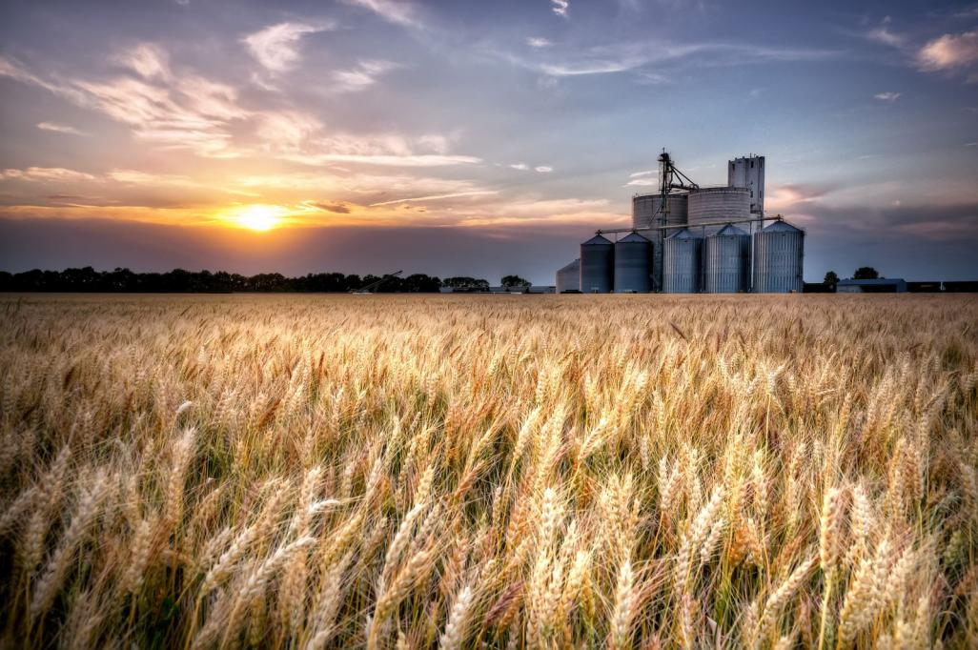
Phosphorus Removal
University of Kansas
100th Annual Water and Wastewater School
Lawrence, Kansas
July 30, 2019
Grant Weaver, PE & wastewater operator
G.Weaver@CleanWaterOps.com

Slide 2


Operational Strategies for Nutrient Removal
Nutrient Removal Overview
Nitrogen Removal
Science & Technology
Applying what we’ve learned
Phosphorus Removal
Science & Technology
Applying what we’ve learned
Aero-Mod Phosphorus and Nitrogen Removal

Slide 3


Slide 4
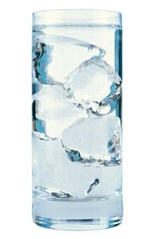
Wastewater Science
Alkalinity and pH

Slide 5


ORP (Oxygen Reduction Potential)
Wastewater Science
DO and ORP
DO (Dissolved Oxygen)

Slide 6
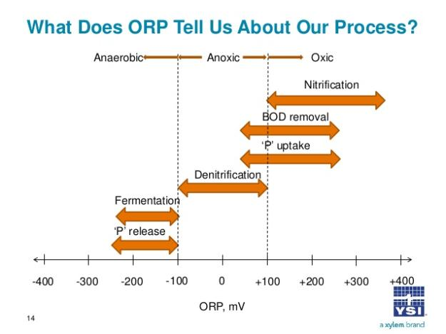

Slide 7

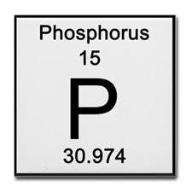

Slide 8
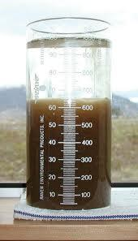
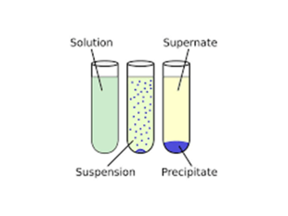
Phosphorus Removal:
What an Operator needs to know
  ONE. Convert soluble phosphorus to TSS …
  Biologically
  Chemically
  TWO. Remove TSS

Slide 9
Biological Phosphorus Removal
  Step 1: prepare “dinner”
  VFA (volatile fatty acids) production in anaerobic/fermentive conditions
  Step 2: “eat”
  Bio-P bugs (PAOs) eat VFAs in anaerobic/fermentive conditions … temporarily releasing more P into the water
  Step 3: breathe and grow
  Bio-P bugs (PAOs) take in almost all of the soluble P in aerobic conditions as they grow and reproduce

Slide 10
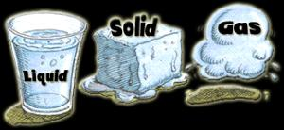
Phosphorus Removal:
What an Operator needs to know
  orthophosphate = soluble phosphorus
  ortho-Phosphate, reactive phosphorus, phosphate, ortho-P, PO_{4,} PO₄⁼, PO₄⁻²
  total-Phosphorus = soluble + particulate phosphorus
  phosphorus, total-P, TP, t-P, tP, P

Slide 11
Typical plant
Influent phosphorus: 6 mg/L
Effluent phosphorus: 3 mg/L
Effluent TSS: 15 mg/L
Effluent total-P = particulate P + soluble P
How much effluent phosphorus is soluble and how much is in the TSS?
Approximately 1% of effluent TSS (conventional plant) is phosphorus …
Effluent P = particulate P + soluble P
Particulate (P in the TSS): 15 mg/L TSS x 0.01 = 0.15 mg/L
Soluble = 3 mg/L – 0.15 mg/L with TSS = 2.85 mg/L

Slide 13
Converting SOLUBLE phosphorus to PARTICULATE phosphorus
Biological Phosphorus removal, when fully optimized, will remove all but 0.05 mg/L of the soluble Phosphorus
and
Chemical Phosphorus removal, the same, all but 0.05 mg/L
Either way, only 0.05 mg/L of soluble Phosphorus remains; most all of it is particulate Phosphorus … that is, effluent TSS
Meanwhile …
The vast majority of the soluble phosphorus is converted to particulate phosphorus; increasing the percentage of the MLSS and TSS that is P from ~1% to ~5%

Slide 15
TSS Removal Requirements
P Limit | max TSS
0.1 | 1
0.2 | 3
0.3 | 5
0.4 | 7
0.5 | 9
0.6 | 11
0.7 | 13
0.8 | 15
0.9 | 17
1.0 | 19
1.1 | 21
1.2 | 23
1.3 | 25
1.4 | 27
1.5 | 29
Since all but 0.05 mg/L of the soluble Phosphorus can be converted to TSS Phosphorus (Biologically and/or Chemically)
And, because approximately 5% of Effluent TSS is Phosphorus
… To meet a total-P limit, the effluent TSS needs to be kept to the max TSS number shown in the table.

Slide 16
Phosphorus Removal without Facility Upgrades
 | total-Phosphorus (mg/L)
 | before | after
Conrad, Montana | 2.1 | 0.15
Keene, New Hampshire | 1.0 | 0.20 | 50% less chemicals
Chinook, Montana | 2.8 | 0.30
East Haddam, Connecticut (2 month trial) | 3.5 | 0.35
Palmer, Massachusetts | 0.5 | 0.50 | 25% less chemicals
Westfield, Massachusetts | 0.5-2.5 | 0.50 | 50% less chemicals
Athens, Tennessee: Oostanaula | 0.5 | 0.50 | 100% less chemicals
Plainfield, Connecticut: Village Plant | 2.5 | 0.70
Suffield, Connecticut | 3.0 | 0.70
Cookeville, Tennessee | 2.0 | 1.4
Helena, Montana | 2.9 | 0.5-2.0
Athens, Tennessee: North Mouse Creek | 2.8 | 0.3-3.0

Slide 17
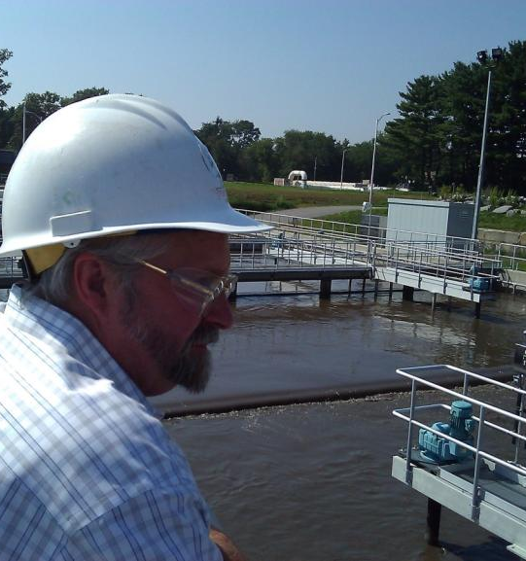

Biological Phosphorus Removal:
Mainstream Flow Fermentation Processes

Slide 18
Bio-P Removal: Mainstream Fermentation Process
Primary Clarifier
Anaerobic Tank
Aeration Tank
Secondary Clarifier
VFAs
In Anaerobic Tank …
Bacteria break down complex BOD into VFAs (volatile fatty acids).
Gravity Thickener
Sludge Storage

Slide 19
Bio-P Removal: Mainstream Fermentation Process
Primary Clarifier
Anaerobic Tank
Aeration Tank
Secondary Clarifier
VFAs
PO₄
In Anaerobic Tank …
Bacteria break down complex BOD into VFAs (volatile fatty acids).
PAO bacteria (phosphate accumulating organisms) take in VFAs as energy source & temporarily release PO₄ (phosphate) into solution.
Gravity Thickener
Sludge Storage

Slide 20
Bio-P Removal: Mainstream Fermentation Process
Primary Clarifier
Anaerobic Tank
Aeration Tank
Secondary Clarifier
PO₄
In Anaerobic Tank …
Bacteria break down complex BOD into VFAs (volatile fatty acids).
PAO bacteria (phosphate accumulating organisms) take in VFAs as energy source & temporarily release PO₄ (phosphate) into solution.
In Aeration Tank …
Energized PAO bacteria take PO₄ out of solution.
Gravity Thickener
Sludge Storage

Slide 21
Bio-P Removal: Mainstream Fermentation Process
Primary Clarifier
Anaerobic Tank
Aeration Tank
Secondary Clarifier
PO₄
In Anaerobic Tank …
Bacteria break down complex BOD into VFAs (volatile fatty acids).
PAO bacteria (phosphate accumulating organisms) take in VFAs as energy source & temporarily release PO₄ (phosphate) into solution.
In Aeration Tank …
Energized PAO bacteria take PO₄ out of solution.
Gravity Thickener
Sludge Storage

Slide 22
Bio-P Removal: Mainstream Fermentation Process
Primary Clarifier
Anoxic Tank
Anaerobic Tank
Aeration Tank
Secondary Clarifier
VFAs
PO₄
Pre-anoxic zone to …
Strengthen anaerobic conditions in anaerobic tank
Minimize VFA use by denitrifying bacteria – the ones that convert Nitrate (NO₃) to Nitrogen Gas (N₂) – by “feeding” influent to the denitrifiers.
Gravity Thickener
Sludge Storage

Slide 23
Bio-P Removal: Mainstream Fermentation Process
Primary Clarifier
Anoxic Tank
Anaerobic Tank
Aeration Tank
Secondary Clarifier
PO₄
Pre-anoxic zone to …
Strengthen anaerobic conditions in anaerobic tank
Minimize VFA use by denitrifying bacteria – the ones that convert Nitrate (NO₃) to Nitrogen Gas (N₂) – by “feeding” influent to the denitrifiers.
Gravity Thickener
Sludge Storage

Slide 24
Bio-P Removal: Mainstream Fermentation Process
Primary Clarifier
Anoxic Tank
Anaerobic Tank
Aeration Tank
Secondary Clarifier
PO₄
Pre-anoxic zone to …
Strengthen anaerobic conditions in anaerobic tank
Minimize VFA use by denitrifying bacteria – the ones that convert Nitrate (NO₃) to Nitrogen Gas (N₂) – by “feeding” influent to the denitrifiers.
Gravity Thickener
Sludge Storage

Slide 25
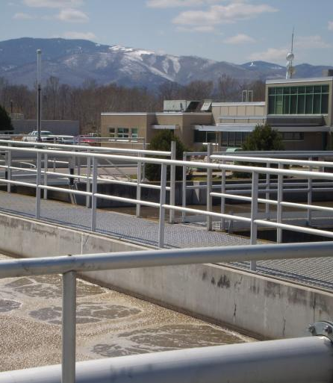
Biological Phosphorus Removal: Combined Sidestream & Mainstream Fermentation

Slide 26
Bio-P Removal: Sidestream Fermentation Process
Primary Clarifier
Anaerobic Tank
Aeration Tank
Secondary Clarifier
VFAs
Gravity Thickener
Fermentation
Sludge Storage

Slide 27
Bio-P Removal: Sidestream Fermentation Process
Primary Clarifier
Anaerobic Tank
Aeration Tank
Secondary Clarifier
VFAs
Gravity Thickener
Fermentation
Sludge Storage

Slide 28
Bio-P Removal: Sidestream Fermentation Process
Primary Clarifier
Anaerobic Tank
Aeration Tank
Secondary Clarifier
VFAs
Gravity Thickener
Fermentation
Sludge Storage

Slide 29
Bio-P Removal: Sidestream Fermentation Process
Primary Clarifier
Anaerobic Tank
Aeration Tank
Secondary Clarifier
PO₄
Gravity Thickener
Fermentation
Sludge Storage

Slide 30
Bio-P Removal: Sidestream Fermentation Process
Primary Clarifier
Anaerobic Tank
Aeration Tank
Secondary Clarifier
PO₄
          Nitrogen Interference:
          Nitrate (NO₃) will consume VFAs
Gravity Thickener
Fermentation
Sludge Storage

Slide 31
Bio-P Removal: Sidestream Fermentation Process
Primary Clarifier
Anoxic Tank
Anaerobic Tank
Aeration Tank
Secondary Clarifier
          No Nitrogen Interference!
Gravity Thickener
Fermentation
Sludge Storage

Slide 32
Bio-P Removal: Sidestream Fermentation Process
Primary Clarifier
Anoxic Tank
Anaerobic Tank
Aeration Tank
Secondary Clarifier
VFAs
          No Nitrogen Interference!
Gravity Thickener
Fermentation
Sludge Storage

Slide 33
Bio-P Removal: Sidestream Fermentation Process
Primary Clarifier
Anoxic Tank
Anaerobic Tank
Aeration Tank
Secondary Clarifier
PO₄
          No Nitrogen Interference!
Gravity Thickener
Fermentation
Sludge Storage

Slide 34
Bio-P Removal: Sidestream Fermentation Process
Primary Clarifier
Anoxic Tank
Anaerobic Tank
Aeration Tank
Secondary Clarifier
PO₄
          No Nitrogen Interference!
Gravity Thickener
Fermentation
Sludge Storage

Slide 35
Optimizing Bio-P Removal:
Mainstream or Sidestream Fermentation
  Anaerobic Tank
          2 hour HRT*
          ORP of -200 mV*
          25 times as much BOD as influent ortho-P*
          Ortho-P release (3 times influent ortho-P)*
  Aeration Tank
          DO of 2.0 mg/L
          ORP of +150 mV
          pH of 7.0+*
          Ortho-P concentration of 0.05 mg/L*
          *Approximate: Every Plant is Different

Slide 36



Slide 37
Review: Biological Phosphorus Removal
  Step 1: prepare “dinner”
  VFA (volatile fatty acids) production in anaerobic/fermentive conditions
  Step 2: “eat”
  Bio-P bugs (PAOs) eat VFAs in anaerobic/fermentive conditions … temporarily releasing more P into the water
  Step 3: breathe and grow
  Bio-P bugs (PAOs) take in almost all of the soluble P in aerobic conditions as they grow and reproduce

Slide 38
Optimizing Bio-P Removal:
Mainstream or Sidestream Fermentation
  Anaerobic Tank
          2 hour HRT*
          ORP of -200 mV*
          25 times as much BOD as influent ortho-P*
          Ortho-P release (3 times influent ortho-P)*
  Aeration Tank
          DO of 2.0 mg/L
          ORP of +150 mV
          pH of 7.0+*
          Ortho-P concentration of 0.05 mg/L*
          *Approximate: Every Plant is Different

Slide 39

Experiment with YOUR plant:
Find the “Right” Process Control Strategy …
Sidestream
Mainstream
Both …
          and,
          Optimize Phosphorus Removal!

Slide 40
Create a Sidestream Fermentation Zone

Slide 41
Bio-P Removal: Grant’s Sidestream Process
Primary Clarifier
Secondary Clarifier
Aeration Tank
Gravity Thickener
Sludge Storage
Fermenter

Slide 42
Bio-P Removal: Grant’s Sidestream Process
Primary Clarifier
Secondary Clarifier
Aeration Tank
VFAs
PO₄
Gravity Thickener
Fermenter

Slide 43
Bio-P Removal: Grant’s Sidestream Process
Primary Clarifier
Secondary Clarifier
Aeration Tank
PO₄
Gravity Thickener
Fermenter

Slide 44
Bio-P Removal: Grant’s Sidestream Process
Primary Clarifier
Secondary Clarifier
Aeration Tank
PO₄
Gravity Thickener
Fermenter

Slide 45
Bio-P Removal: Grant’s Sidestream Process
Primary Clarifier
Secondary Clarifier
Aeration Tank
PO₄
Gravity Thickener
Fermenter

Slide 46
Optimizing Bio-P Removal: Mainstream, Sidestream or Combination Fermentation
  Anaerobic Tank
          2 hour HRT*
          ORP of -200 mV*
          25 times as much BOD as influent ortho-P*
          Ortho-P release (3 times influent total-P)*
  Aeration Tank
          High DO (2.0 mg/L*)
          High ORP (+150 mV*)
          pH of 6.8+*
          Ortho-P concentration of 0.05 mg/L*
          *Approximate: Every Plant is Different

Slide 47
Create a Mainstream Fermentation Zone

Slide 48
Mainstream Bio-P Removal in Conventional Activated Sludge Plant
Primary Clarifier
Anaerobic Tank
Aeration Tank
Secondary Clarifier
VFAs
Gravity Thickener
Sludge Storage

Slide 49
Mainstream Bio-P Removal in Conventional Activated Sludge Plant
Primary Clarifier
Anaerobic Tank
Aeration Tank
Secondary Clarifier
VFAs
PO₄
Gravity Thickener
Sludge Storage

Slide 50
Mainstream Bio-P Removal in Conventional Activated Sludge Plant
Primary Clarifier
Anaerobic Tank
Aeration Tank
Secondary Clarifier
PO₄
Gravity Thickener
Sludge Storage

Slide 51
Mainstream Bio-P Removal in Conventional Activated Sludge Plant
Primary Clarifier
Anaerobic Tank
Aeration Tank
Secondary Clarifier
PO₄
Gravity Thickener
Sludge Storage

Slide 52

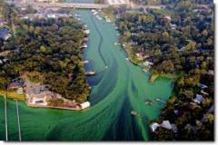

Slide 53


Slide 54
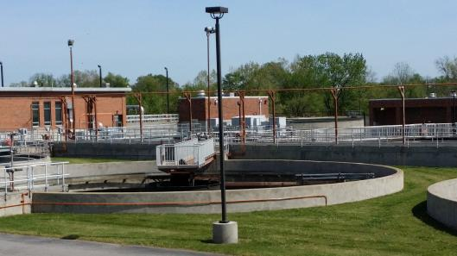

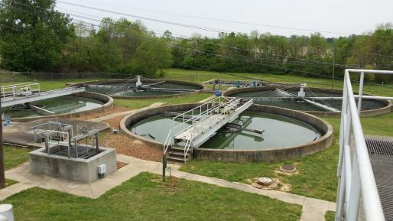
Change day-to-day operations to
create ideal habitats for bacteria to remove Phosphorus

Slide 55
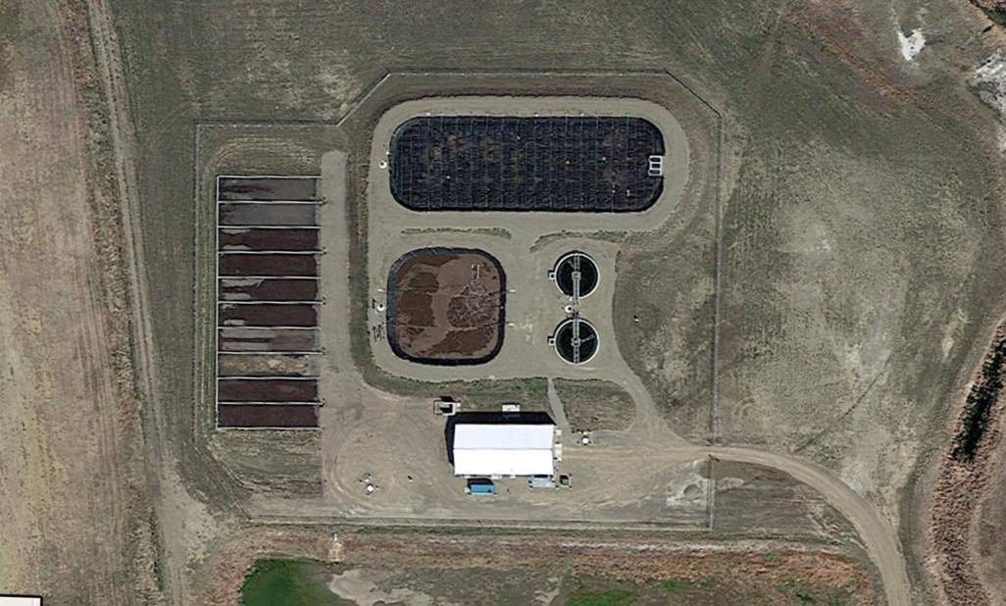
Conrad, Montana Population: 2,500 0.5 MGD design flow

Slide 56
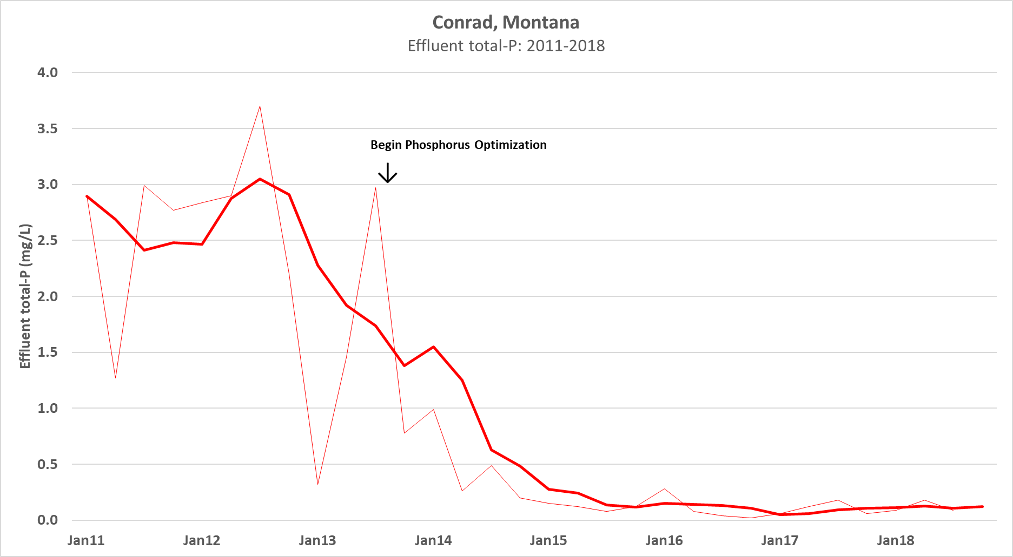

Slide 57
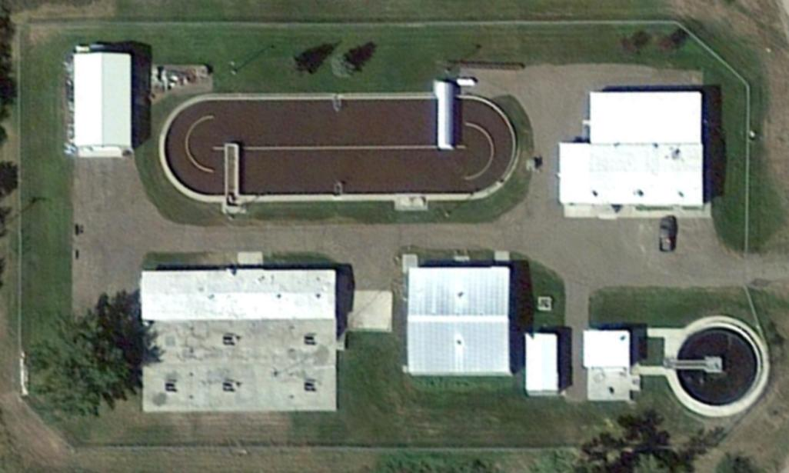
Chinook, Montana Population: 1,250 0.5 MGD design flow

Slide 58
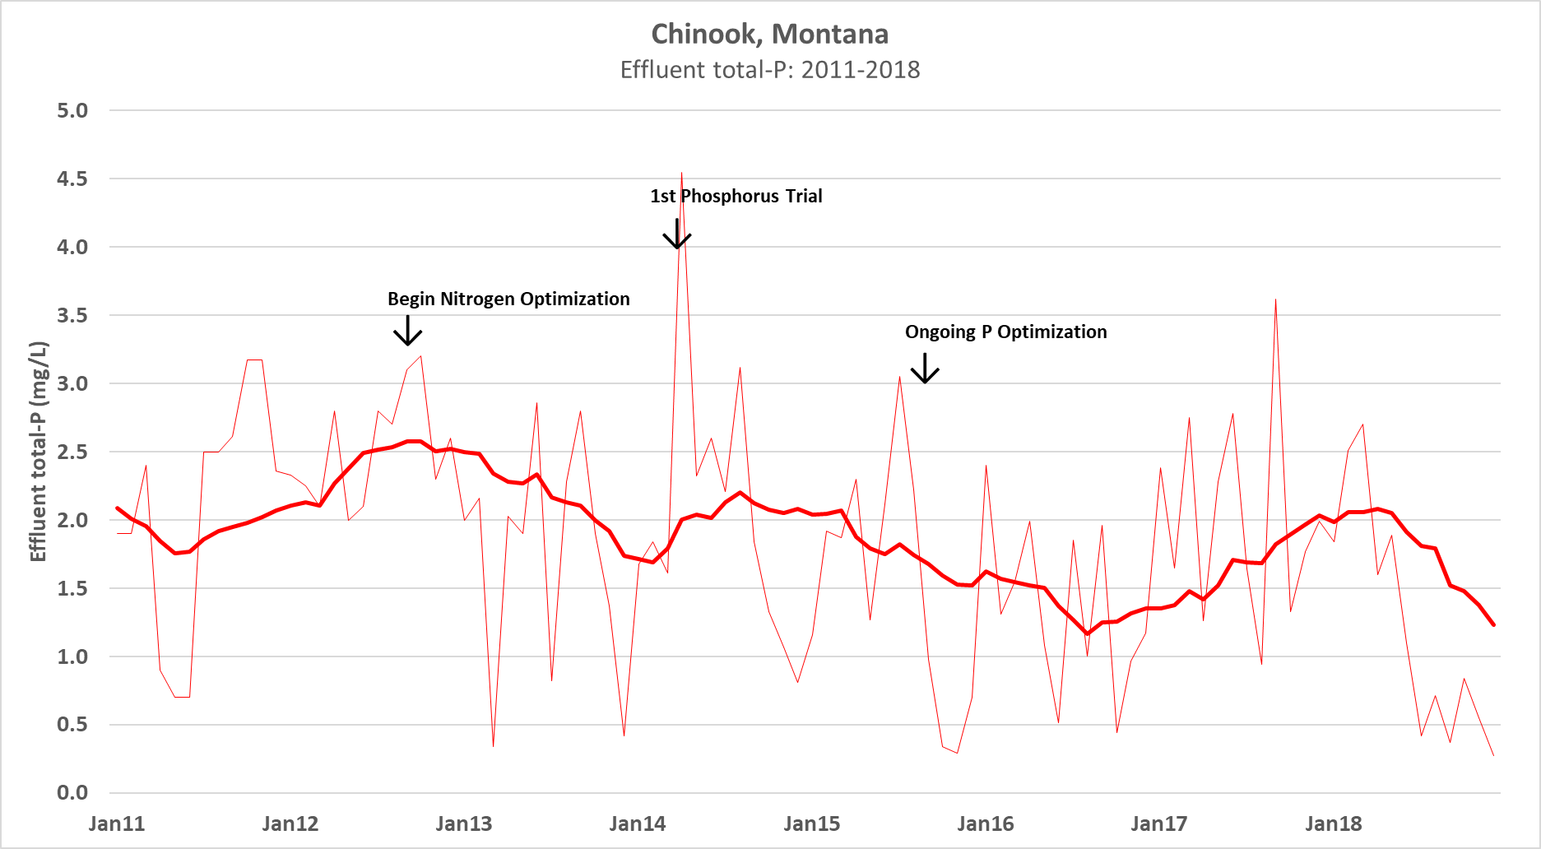

Slide 59
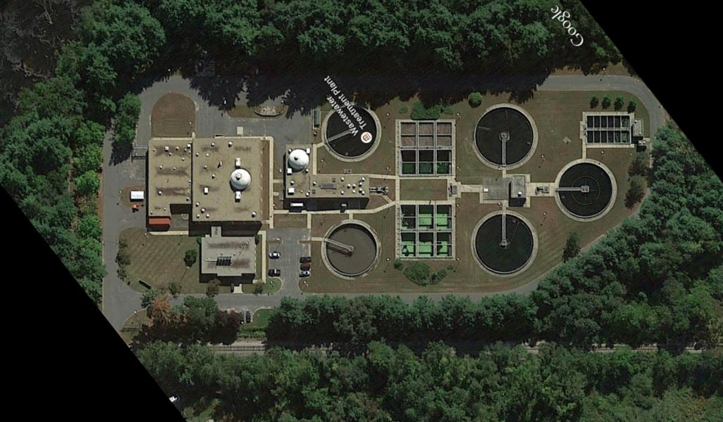
Palmer, Massachusetts Population: 12,200 5.6 MGD design

Slide 60
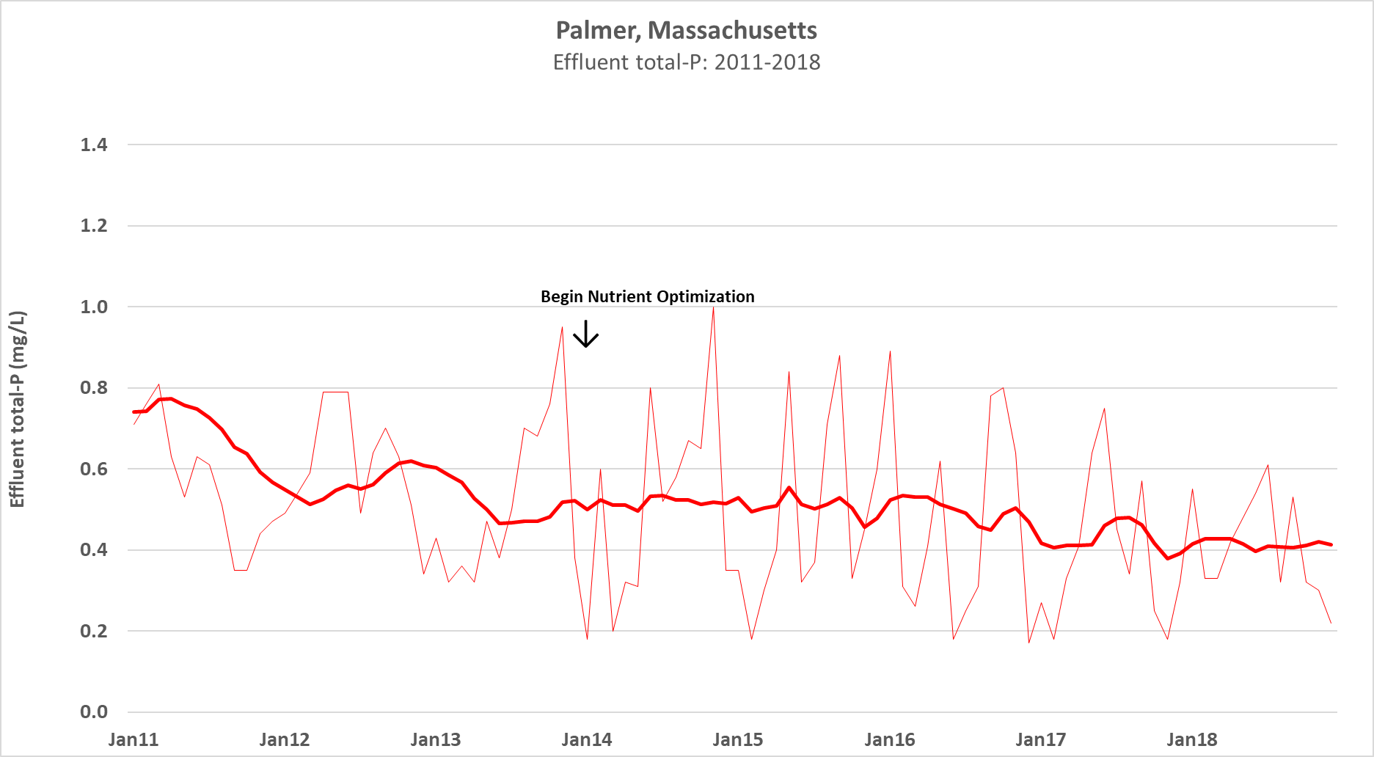

Slide 61
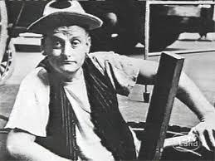
Comments & Questions
Grant Weaver
g.weaver@cleanwaterops.com

