Slide 1
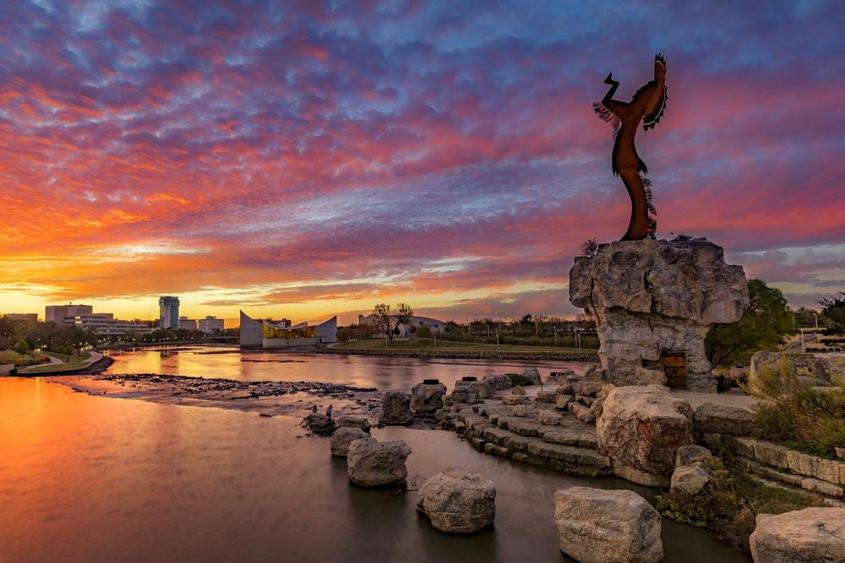
Nutrient Removal
Introduction and Overview
University of Kansas
100th Annual Water and Wastewater School
Lawrence, Kansas
July 30, 2019
Grant Weaver, PE & wastewater operator
G.Weaver@CleanWaterOps.com

Slide 2


Operational Strategies for Nutrient Removal
Nutrient Removal Overview
Nitrogen Removal
Science & Technology
Applying what we’ve learned
Phosphorus Removal
Science & Technology
Applying what we’ve learned
Aero-Mod Phosphorus and Nitrogen Removal

Slide 3
Nutrient Removal Overview
What are Nutrients?
  Nitrogen
  Phosphorus

Slide 4
Nutrient Removal Overview
What are Nutrients?
  Nitrogen (total-Nitrogen, including organic-Nitrogen, Ammonia, Nitrite and Nitrate)
  Phosphorus

Slide 5
Nutrient Removal Overview
What are Nutrients?
  Nitrogen (total-Nitrogen, including organic-Nitrogen, Ammonia, Nitrite and Nitrate)
  Phosphorus (total-Phosphorus including orthophosphate, ortho-P, and insoluble P)

Slide 6
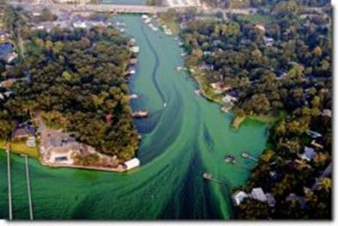
Nutrient Removal Overview
What are Nutrients?
  Nitrogen (total-Nitrogen, including organic-Nitrogen, Ammonia, Nitrite and Nitrate)
  Phosphorus (total-Phosphorus including orthophosphate, ortho-P, and insoluble P)
Why Should Operators Care About Nutrient Removal?
  Algae blooms, Eutrophication
  Because EPA and states are putting N&P limits in municipal permits

Slide 7
Nutrient Removal Overview
What are Nutrients?
  Nitrogen (total-Nitrogen, including organic-Nitrogen, Ammonia, Nitrite and Nitrate)
  Phosphorus (total-Phosphorus including orthophosphate, ortho-P, and insoluble P)
Why Should Operators Care About Nutrient Removal?
  Algae blooms, Eutrophication
  Because EPA and states are putting N&P limits in municipal permits
How to Remove?
  Nitrogen: Biologically
  Phosphorus: Chemically, Biologically, or Combination

Slide 8
Nutrient Removal Overview
What are Nutrients?
  Nitrogen (total-Nitrogen, including organic-Nitrogen, Ammonia, Nitrite and Nitrate)
  Phosphorus (total-Phosphorus including orthophosphate, ortho-P, and insoluble P)
Why Should Operators Care About Nutrient Removal?
  Algae blooms, Eutrophication
  Because EPA and states are putting N&P limits in municipal permits
How to Remove?
  Nitrogen: Biologically
  Phosphorus: Chemically, Biologically, or Combination
  At What Cost?
  Facility Upgrades: generally very expensive
  Optimization: often almost free

Slide 9
Kansas Nutrient Reduction Strategy
Conceived in 2004 as an alternative to establishing numeric nutrient criteria
Major Mechanical Plants were asked to assess feasibility and cost of nutrient removal at three levels:
Biological Nutrient Removal: TP – 1.5 mg/l; TN – 8 mg/l
[later evolved to 1 mg/l TP & 10 mg/l TN]
Enhanced Nutrient Removal: TP – 0.5 mg/l; TN – 5 mg/l
Limits of Technology: TP – 0.3 mg/l; TN – 3 mg/l
Priority of Total Maximum Daily Loads over 2012 – 2022 emphasized phosphorus & nitrate impairments
Wasteload Allocations (WLAs) from TMDLs based on BNR or ENR goals and design flows
Wasteload Allocations for Lagoons assumed they could achieve 2 mg/l TP & 10 mg/l TN
Permit Limits are mass-based (pounds/day) from WLAs required as rolling 12-month averages
TN limits established as Ammonia (2013 acute & chronic criteria) & Nitrate limit of 10 mg/l,
if required by a Nitrate TMDL
Antidegradation Review of New or Expanding Mechanical Plants typically impose ENR based limits

Slide 10
Kansas Nutrient Reduction Strategy
total-Nitrogen total-Phosphorus
Mechanical Plants 10 mg/L 1.0 mg/L
Lagoons no change no change

Slide 11
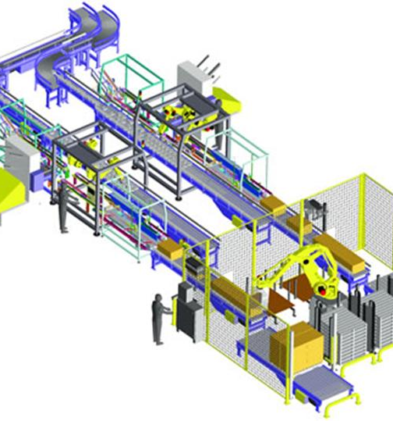

Historical approach: Technology!

Slide 12
Cost of Nutrient Removal:
Construction Costs and Operation & Maintenance Costs for a …
1 MGD wastewater treatment plant
Kansas Average
Design & Construct
10 mg/L Nitrogen Removal
and 1 mg/L Phosphorus Removal: $8 million

Slide 13
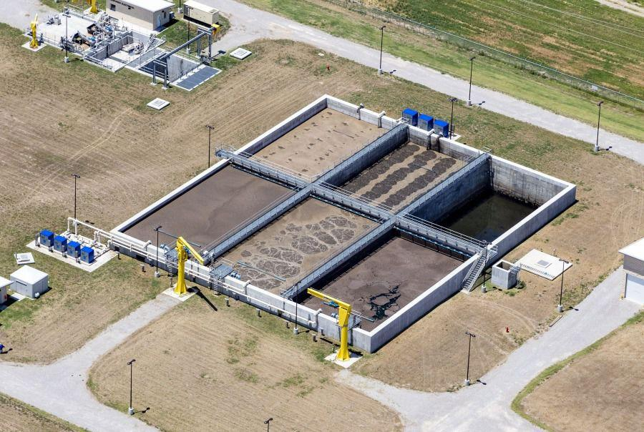
SBR:
Sequencing Batch Reactor

Slide 14
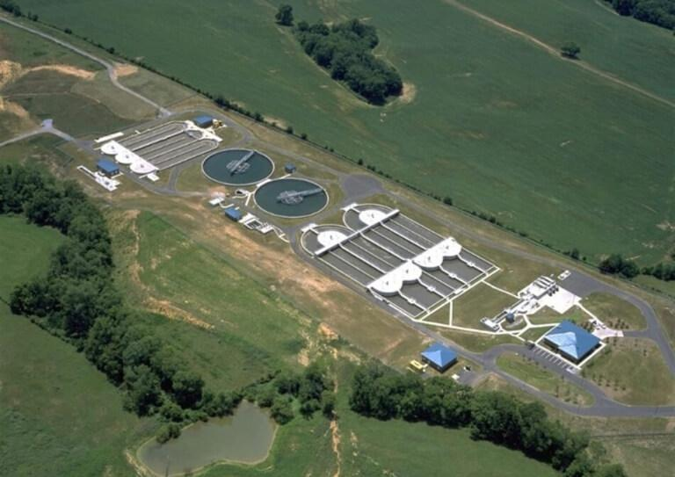
Oxidation Ditch with pre-anaerobic zone

Slide 15
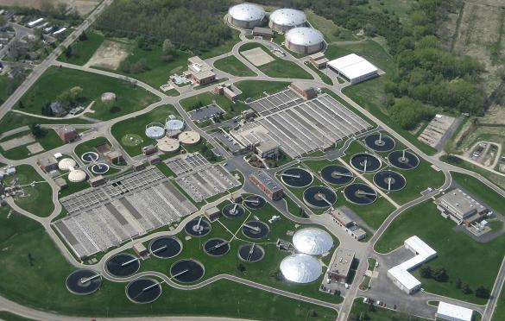
MLE:
Modified Luczak-Ettinger

Slide 16
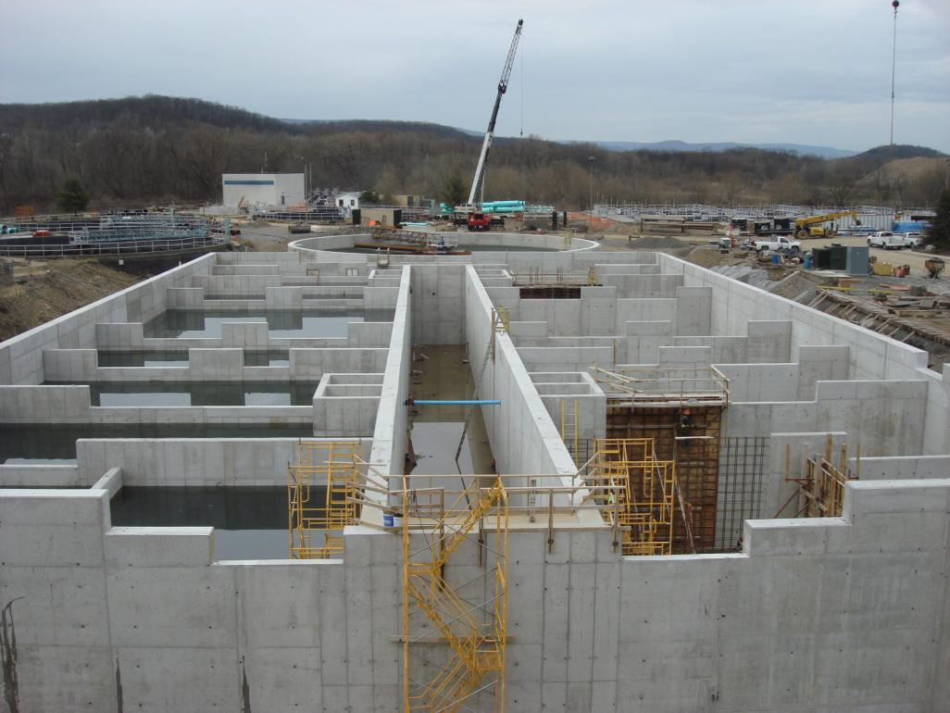
Modified Johannesburg

Slide 17

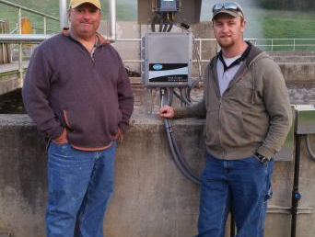

New way of thinking:
Operators’ skills matter!

Slide 18
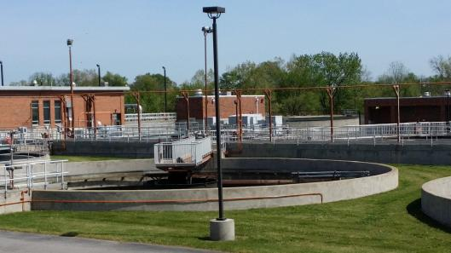

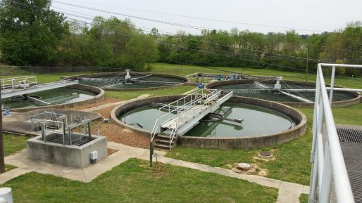
Change day-to-day operations to
create ideal habitats for bacteria to remove Nitrogen & Phosphorus

Slide 19
Connecticut
Colchester-East Hampton
East Haddam
Farmington
Groton
New Canaan
New Hartford
Plainfield
Portland
Suffield
Windham
Iowa
Eldora
Kansas
Basehor
Eudora
Hiawatha
Holden
Lansing
Osawatomie
Shawnee Co. Sherwood
Spring Hill
St. Marys
Topeka North
Wellsville
Kentucky
Hopkinsville
Massachusetts
Amherst
Barnstable
Easthampton
Greenfield
Montague
Newburyport
Northfield
Palmer
South Deerfield
South Hadley
Sunderland
Upton
Westfield
Montana
Bigfork
Big Sky
Billings
Boulder
Bozeman
Butte
Chinook
Choteau
Colstrip
Columbia Falls
Conrad
Dillon
East Helena
Forsyth
Glendive
Great Falls
Hamilton
Hardin
Havre
Helena
Kalispell
Laurel
Lewistown
Libby
Lolo
Miles City
Missoula
New Hampshire
Keene
South Carolina
Greeneville
Tennessee
Athens
Baileyton
Bartlett
Collierville
Cookeville
Crossville
Humboldt
Lafayette
LaFollette
Livingston
Millington
Missoula
Nashville
Norris
Oak Ridge
Texas
Nottingham MUD (Houston)
Virginia
Strasburg
Wyoming
Laramie

Slide 20
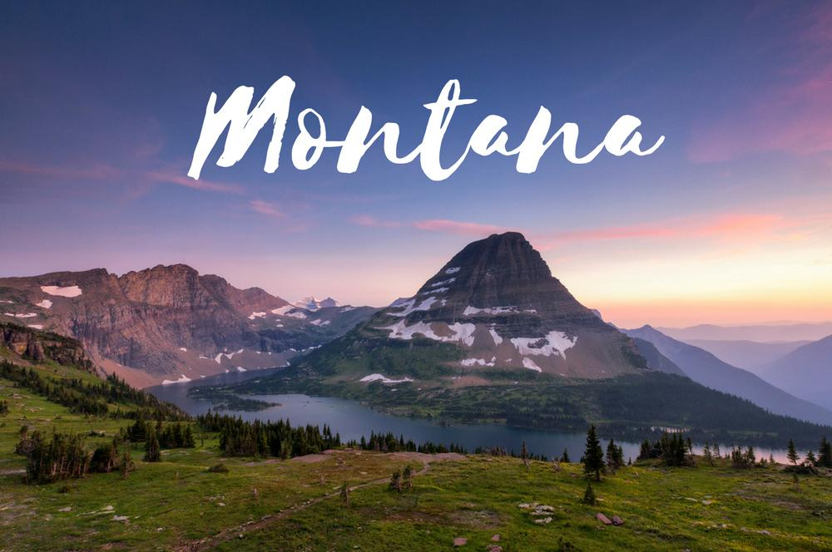

Slide 21
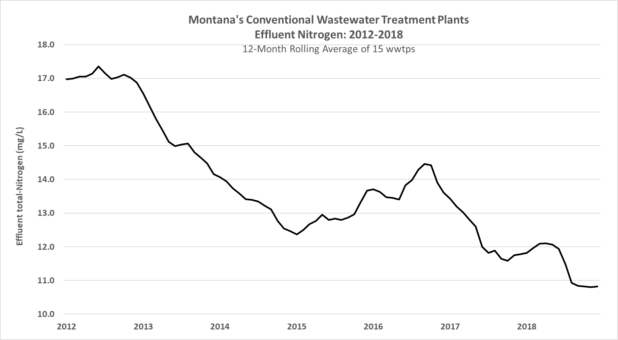
Notes:
[Grant picks it up here]
The average unit costs for the upgraded facilities were 521 times greater than the average unit costs for the optimized conventional plants.
Capital Improvement:
It’s what we do … make changes that are “guaranteed” to remove nutrients for next 20 years.
Optimization:
Practical, get-the-most with what you have first step to fixing environmental issues.
Sometimes the first and last step!
Optimization is a good approach to try first to meet new or anticipated nutrient reduction goals because:
It’s low-cost
It can reach achieve relatively low effluent levels
It is applicable to a wide-variety of plant types, influent characteristics, and climatic conditions

Slide 22
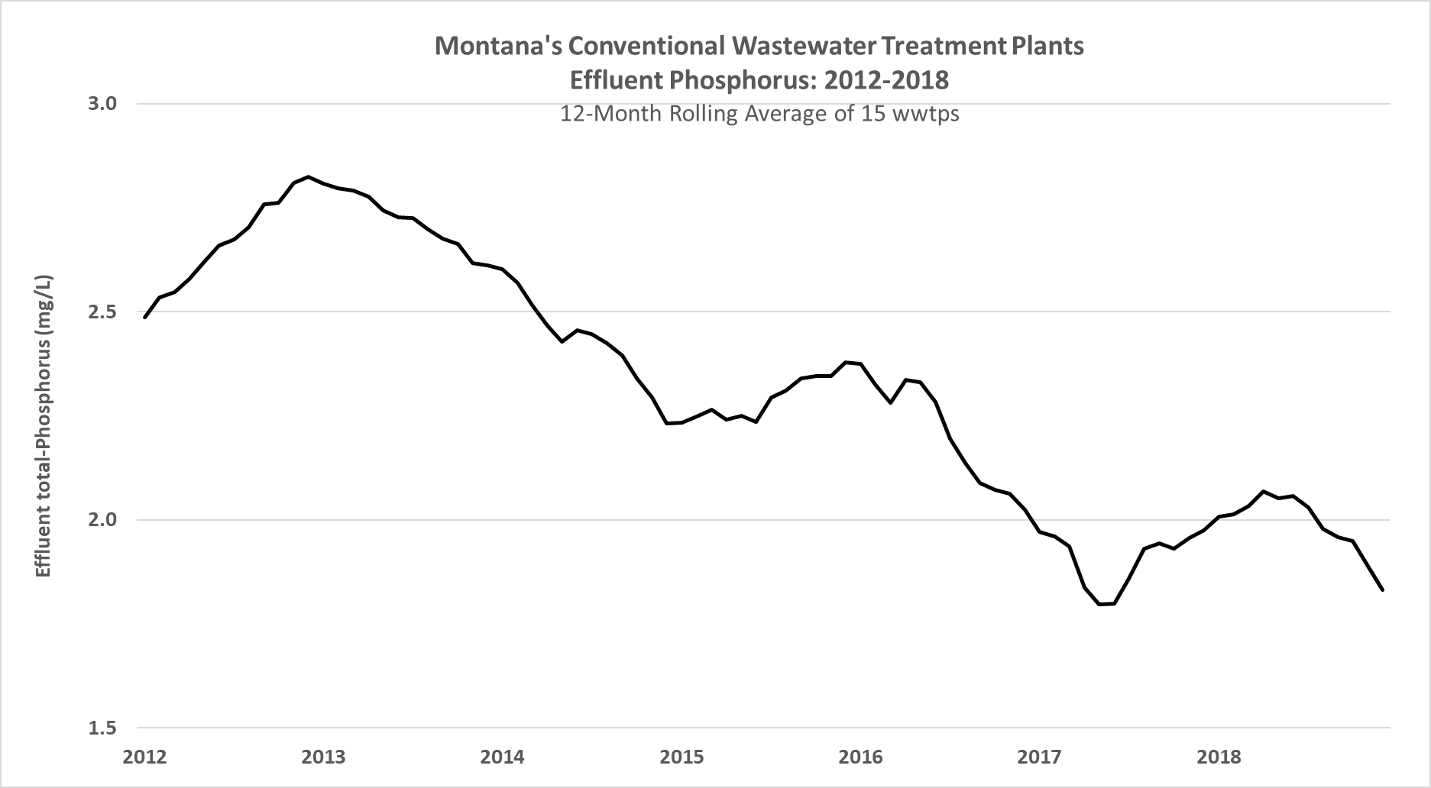
Notes:
[Grant picks it up here]
The average unit costs for the upgraded facilities were 521 times greater than the average unit costs for the optimized conventional plants.
Capital Improvement:
It’s what we do … make changes that are “guaranteed” to remove nutrients for next 20 years.
Optimization:
Practical, get-the-most with what you have first step to fixing environmental issues.
Sometimes the first and last step!
Optimization is a good approach to try first to meet new or anticipated nutrient reduction goals because:
It’s low-cost
It can reach achieve relatively low effluent levels
It is applicable to a wide-variety of plant types, influent characteristics, and climatic conditions

Slide 23
Comparing Performance of Montana's BNR Facilities and
Optimized Conventional Wastewater Treatment Plants
Advanced (BNR) WWTFs |  |  |  |  |  | Conventional WWTFs
 | total-N |  | total-P |  |  |  | total-N |  | total-P
Bozeman, MT | 5 | mg/L | 0.3 | mg/L |  | Chinook, MT | 3 | mg/L | 1.2 | mg/L
Missoula, MT | 9 | mg/L | 0.2 | mg/L |  | Conrad, MT | 7 | mg/L | 0.1 | mg/L
Kalispell, MT | 8 | mg/L | 0.2 | mg/L |  | Hardin, MT | 5 | mg/L | 2.4 | mg/L
Lewistown, MT | 2 | mg/L | 1.0 | mg/L |  | Hamilton, MT | 3 | mg/L | 4.0 | mg/L
Combined Cost: $70 million |  |  |  |  |  | Combined Cost: $20,000
Notes:
[Grant picks it up here]
The average unit costs for the upgraded facilities were 521 times greater than the average unit costs for the optimized conventional plants.
Capital Improvement:
It’s what we do … make changes that are “guaranteed” to remove nutrients for next 20 years.
Optimization:
Practical, get-the-most with what you have first step to fixing environmental issues.
Sometimes the first and last step!
Optimization is a good approach to try first to meet new or anticipated nutrient reduction goals because:
It’s low-cost
It can reach achieve relatively low effluent levels
It is applicable to a wide-variety of plant types, influent characteristics, and climatic conditions

Slide 24

Nitrogen Removal without Facility Upgrades
t-N Before t-N After
Suffield, CT 7 2
Chinook, MT 26 3
Hardin, MT 18 4
Conrad, MT 35 5
Montague, MA 30 5
Cookeville, TN 25 5
Upton, MA 22 6
Plainfield, CT 25 10
Colchester-East Hampton, CT 24 12
Big Sky, MT 25 14
Libby, MT 32 21

Slide 25

Phosphorus Removal without Facility Upgrades
t-P Before t-P After
Conrad, MT 2.1 0.2
Chinook, MT 2.8 0.3
Westfield, MA 1.0 0.5*
Palmer, MA 0.65 0.65*
Cookeville, TN 3 0.8
Montague, MA 3 0.9
Athens, TN 3 1.8*
*chemical reduction of 50% or more

Slide 26


Slide 27
Wastewater treatment for Beginning Operators
Grow bacteria that feed on soluble pollutants
Settle out the bacteria
Send clean water into the stream

Slide 28
Wastewater treatment for Advanced Operators
Grow bacteria that feed on soluble pollutants by maintaining optimal living conditions for the bacteria that treat wastewater
    BOD
    Nitrogen
    Phosphorus
    Alkalinity / pH

Slide 29
Wastewater treatment for Advanced Operators
Grow bacteria that feed on soluble pollutants by maintaining optimal living conditions for the bacteria that treat wastewater
    BOD
    Nitrogen
    Phosphorus
    Alkalinity / pH
Settle out the bacteria by managing clarifiers and excellent process control

Slide 30
Wastewater treatment for Advanced Operators
Grow bacteria that feed on soluble pollutants by maintaining optimal living conditions for the bacteria that treat wastewater
    BOD
    Nitrogen
    Phosphorus
    Alkalinity / pH
Settle out the bacteria by managing clarifiers and excellent process control
Send cleaner water into the stream

Slide 31
Wastewater treatment for Advanced Operators
Grow bacteria that feed on soluble pollutants by maintaining optimal living conditions for the bacteria that treat wastewater
    BOD
    Nitrogen
    Phosphorus
    Alkalinity / pH
Settle out the bacteria by managing clarifiers and excellent process control
Send cleaner water into the stream
Create the right conditions to maximize the controlled release of nitrogen gas

Slide 32
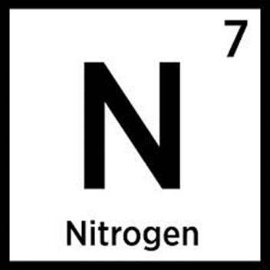
Step 1: Convert Ammonia (NH₄) to Nitrate (NO₃)
          Oxygen-rich
          BOD-poor
          pH of 6.5 or more
Step 2: Convert Nitrate (NO₃) to Nitrogen Gas (N₂)
          Oxygen-poor
          BOD-rich

Slide 33
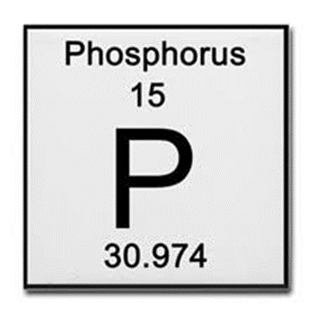
Step 1. Prepare “dinner”
  BOD-rich
  Zero oxygen: anaerobic / fermentation
Step 2. Take bio-P bugs to “dinner”
  Move food to bio-P bugs (PAOs) – or – move bio-P bugs to food
  Zero oxygen: anaerobic / fermentation
  Same tank
  or, not
Step 3. Grow bio-P bugs
  Oxygen-rich
  pH of at least 6.8

Slide 34


Slide 35
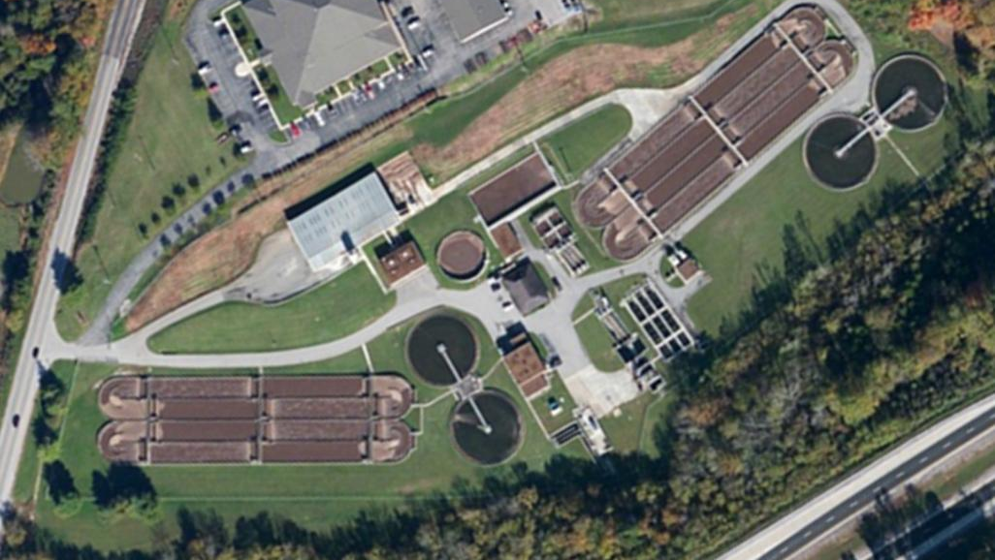
Cookeville, Tennessee Population: 33,500 15 MGD design flow

Slide 36
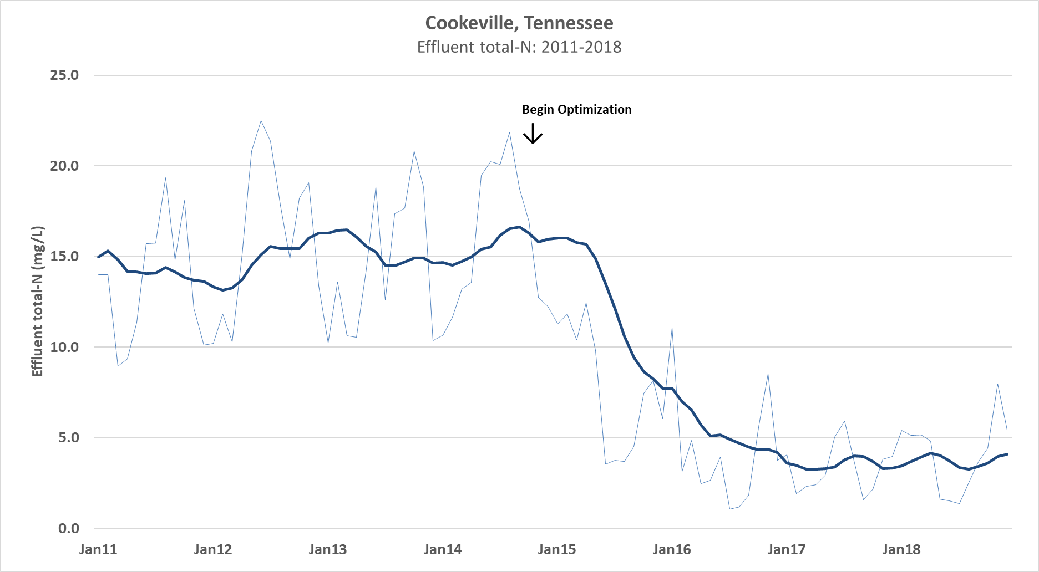

Slide 37
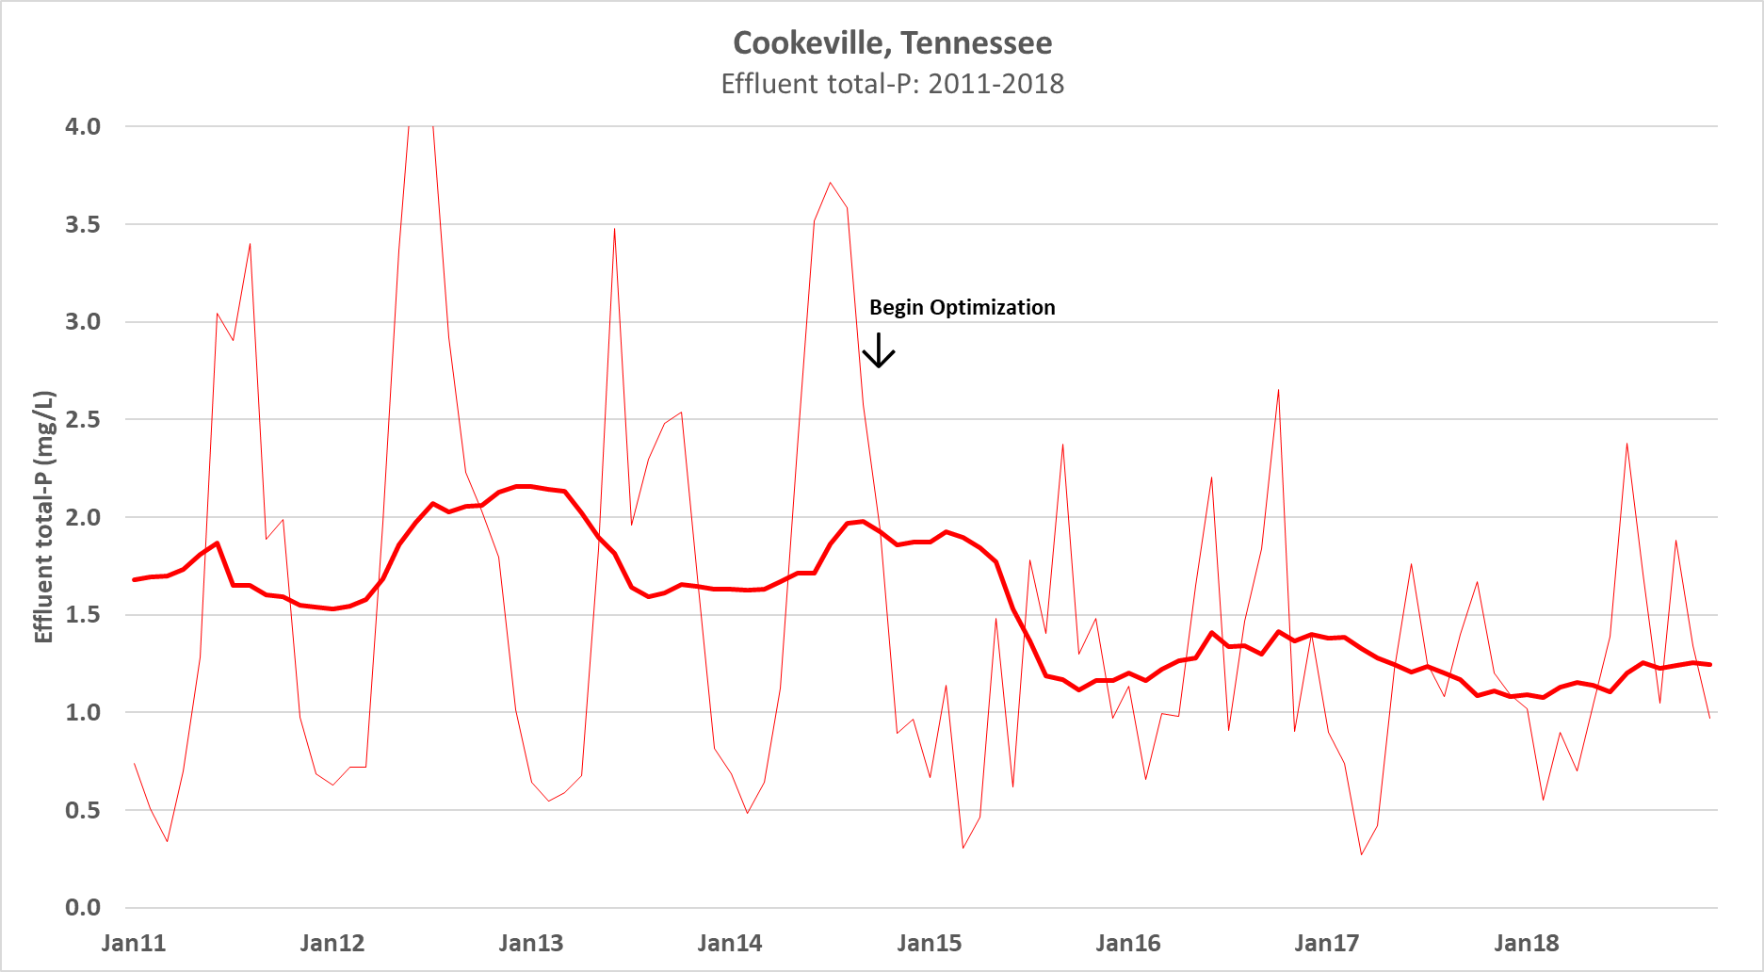

Slide 38
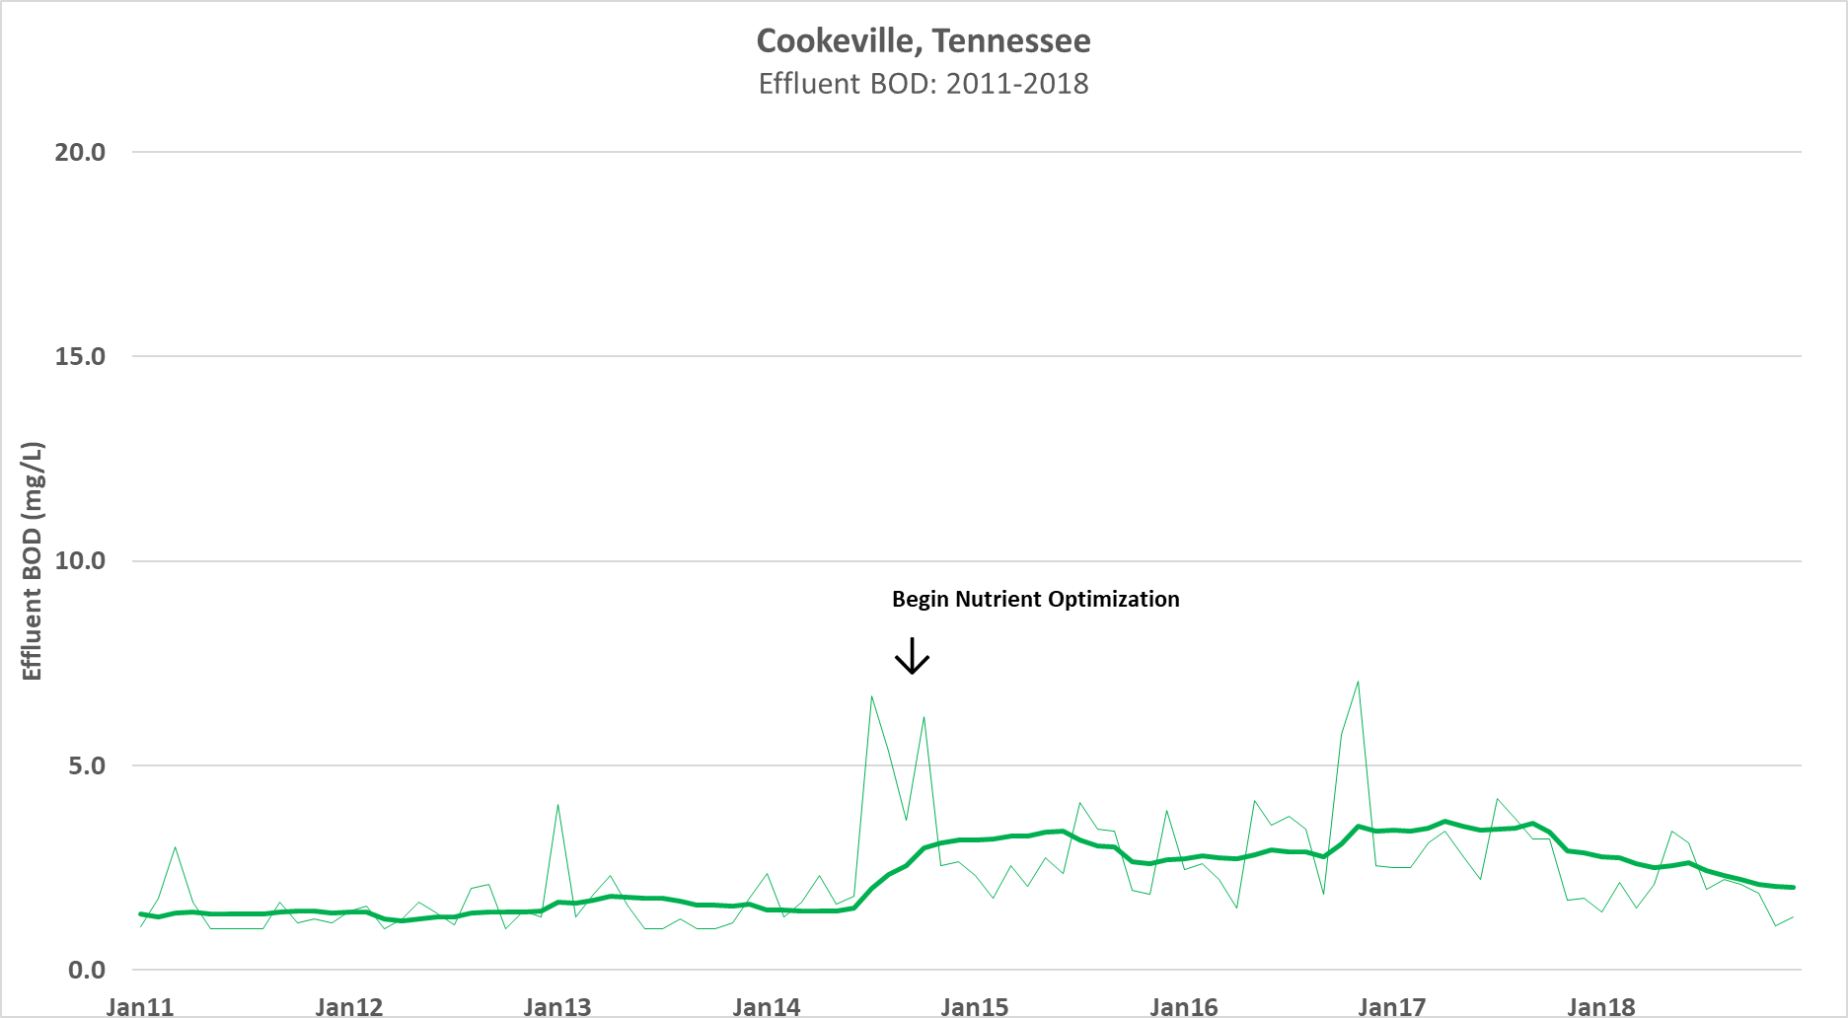

Slide 39
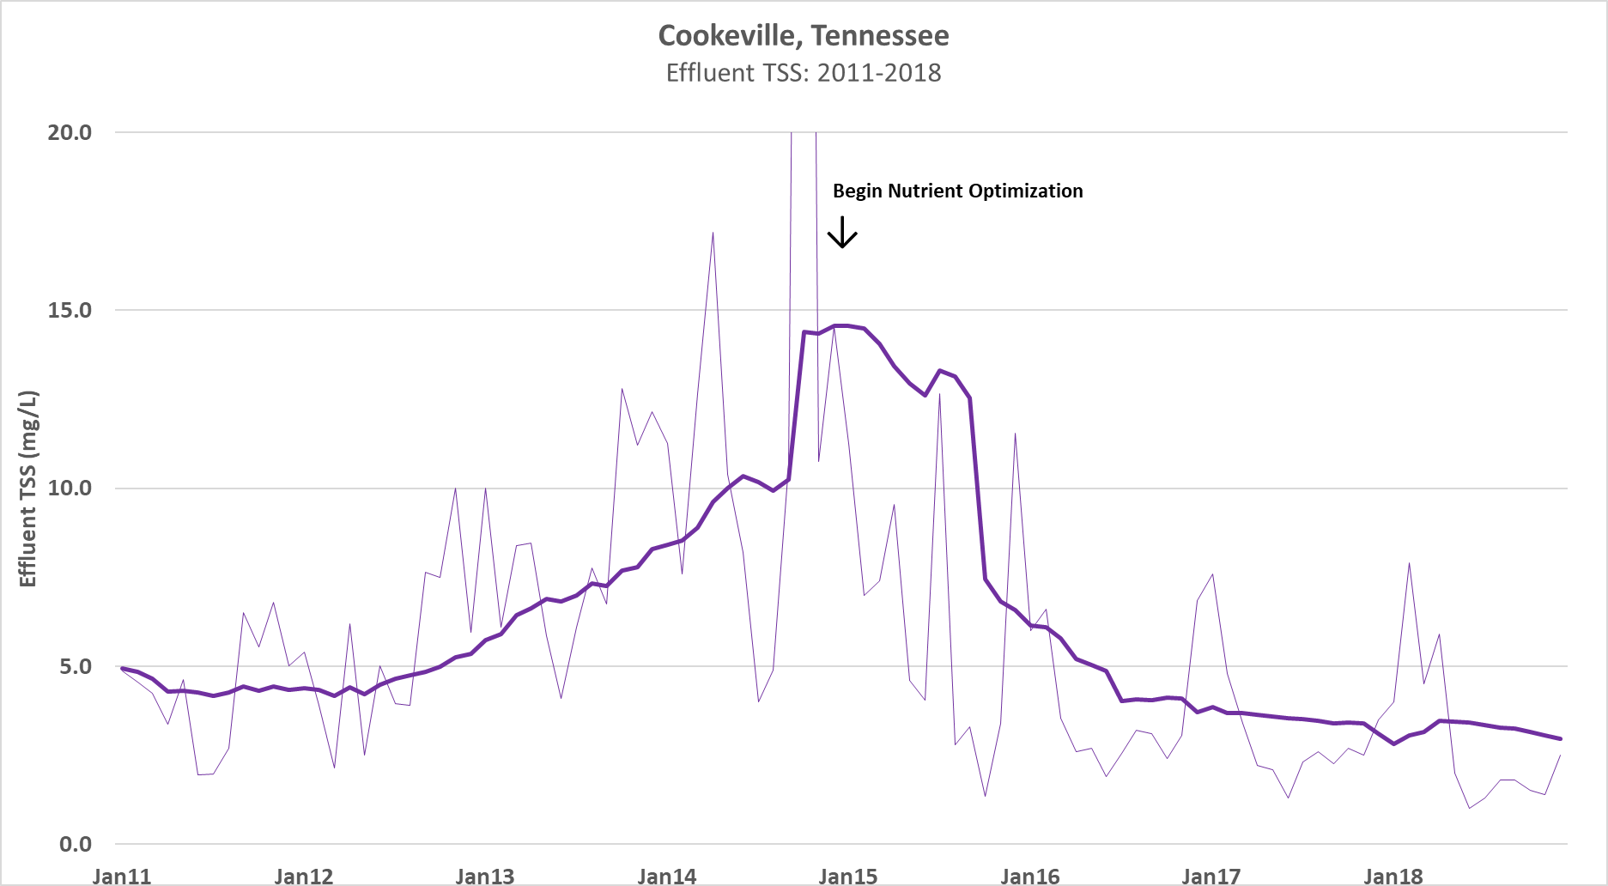

Slide 40
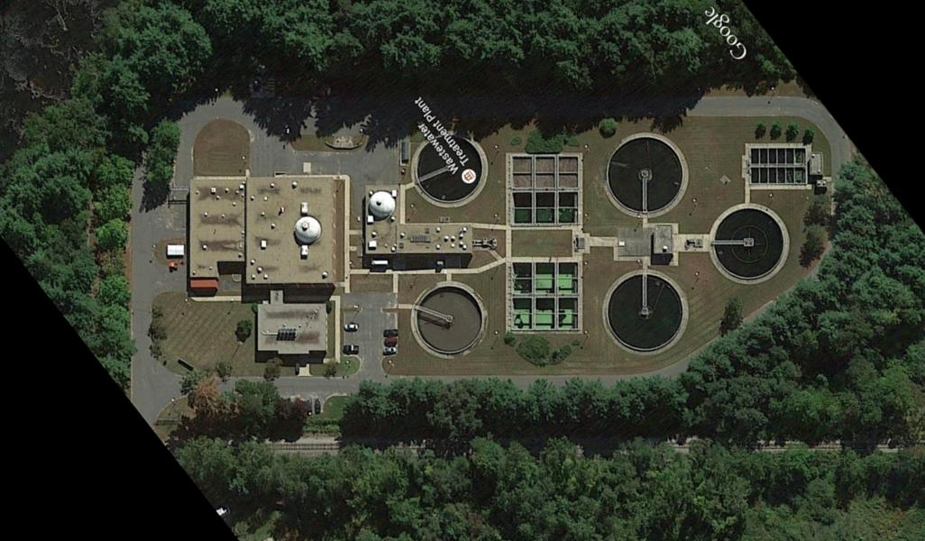
Palmer, Massachusetts Population: 12,200 5.6 MGD design

Slide 41
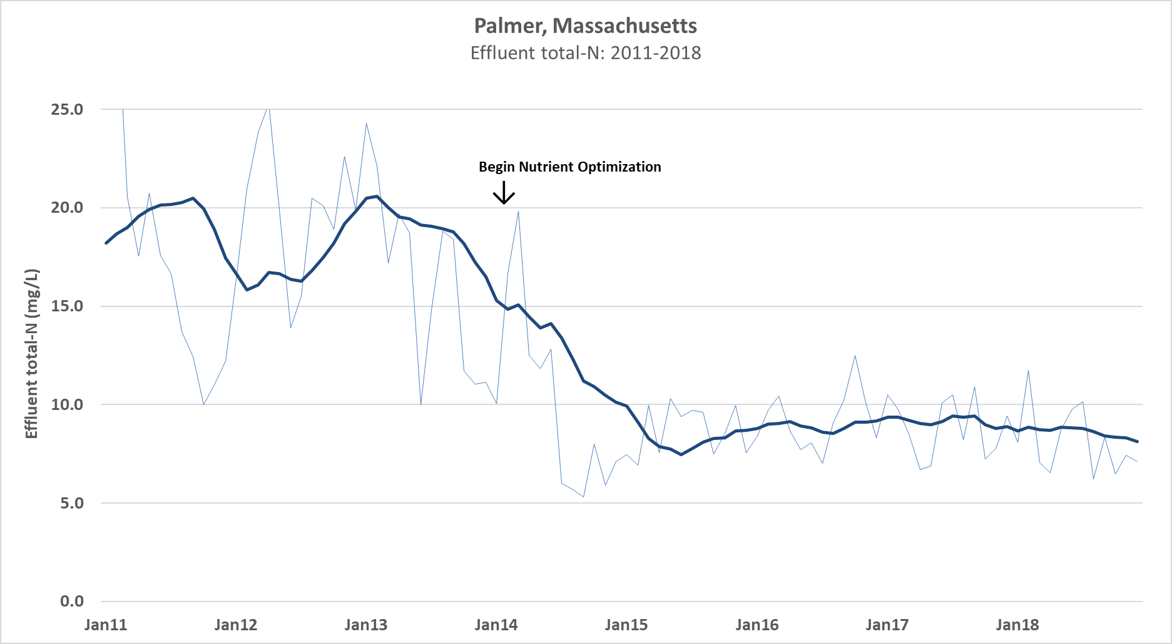

Slide 42
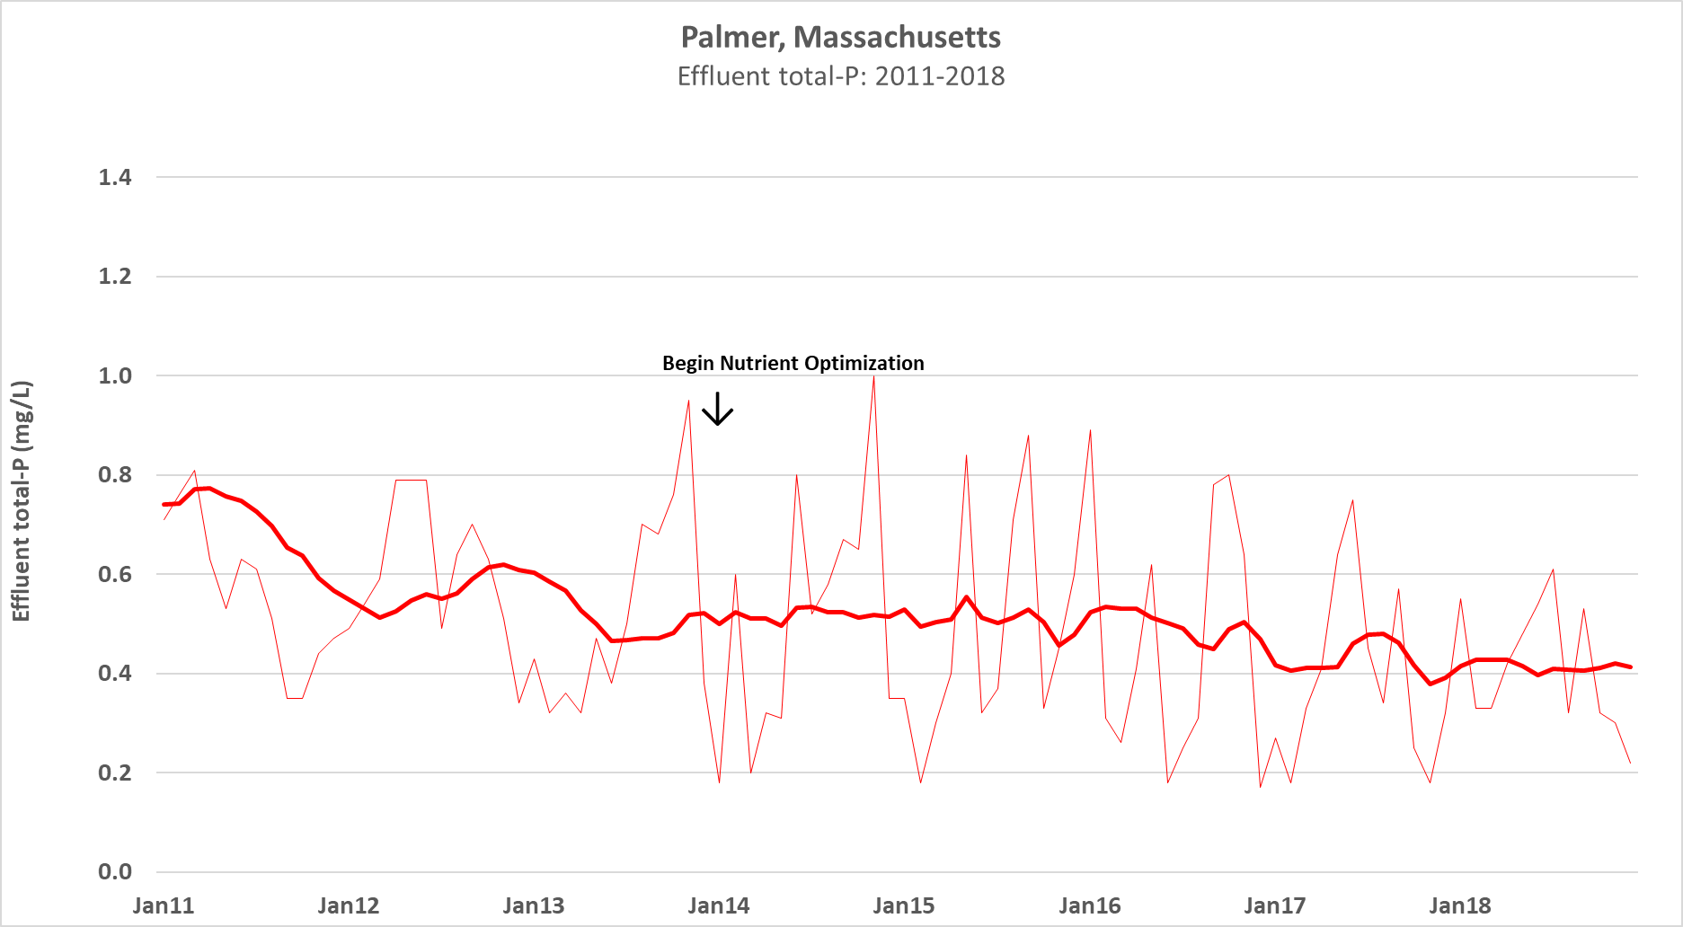

Slide 43
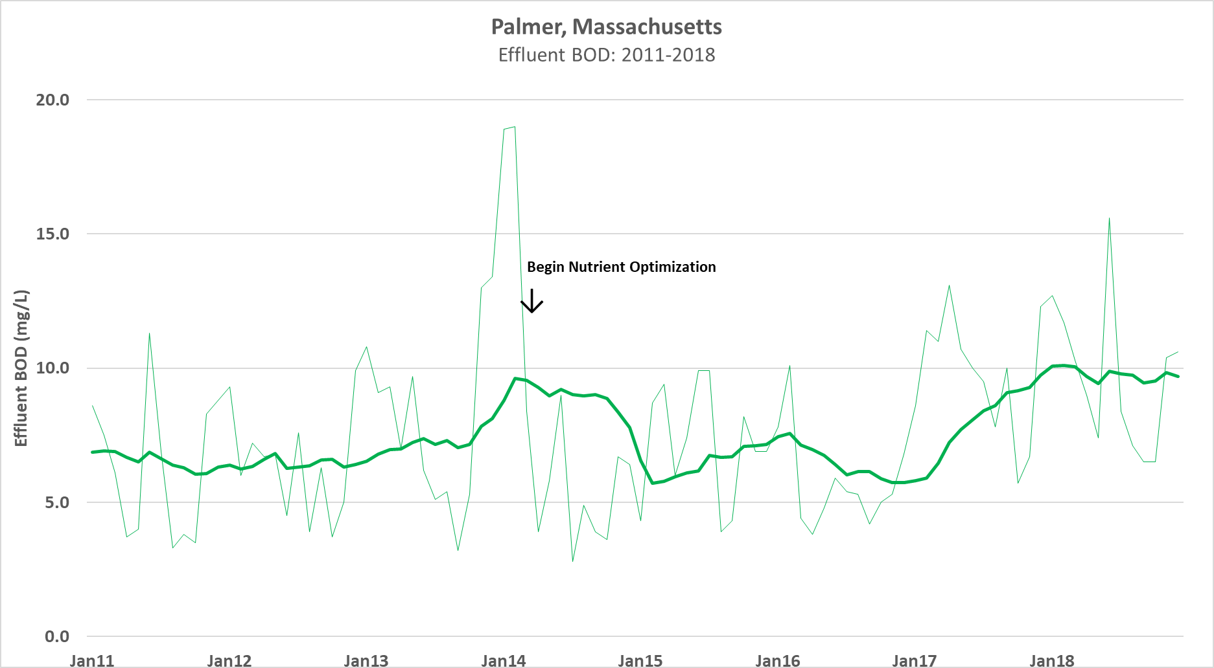

Slide 44
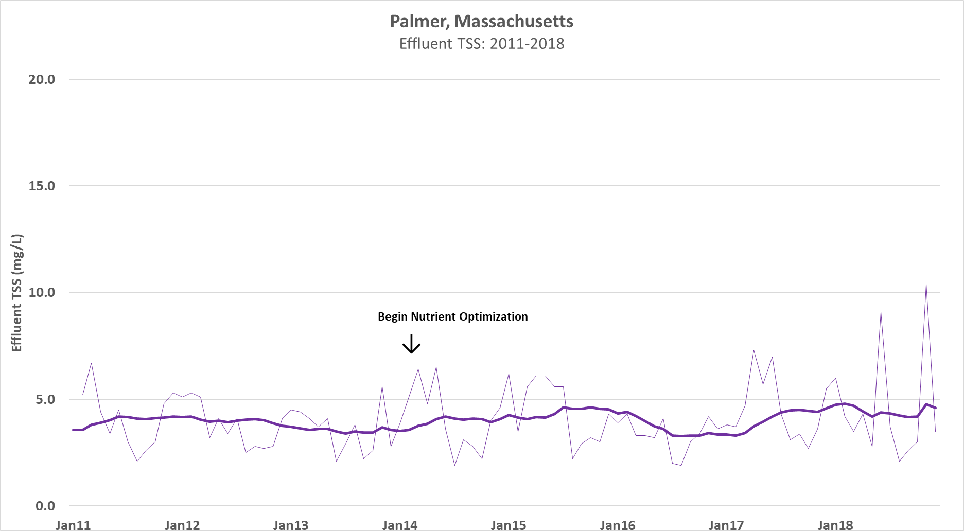

Slide 45
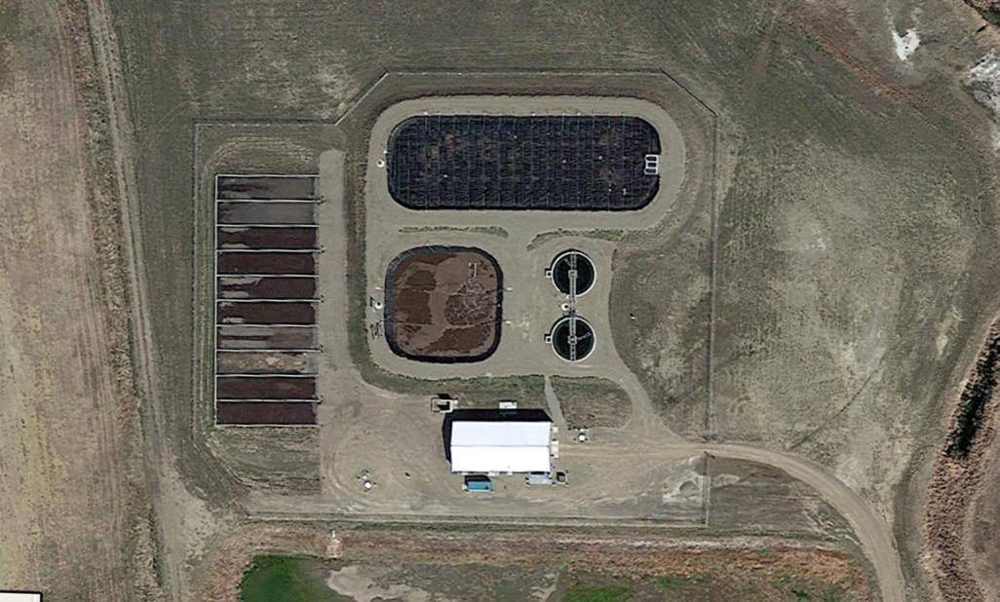
Conrad, Montana Population: 2,500 0.5 MGD design flow

Slide 46
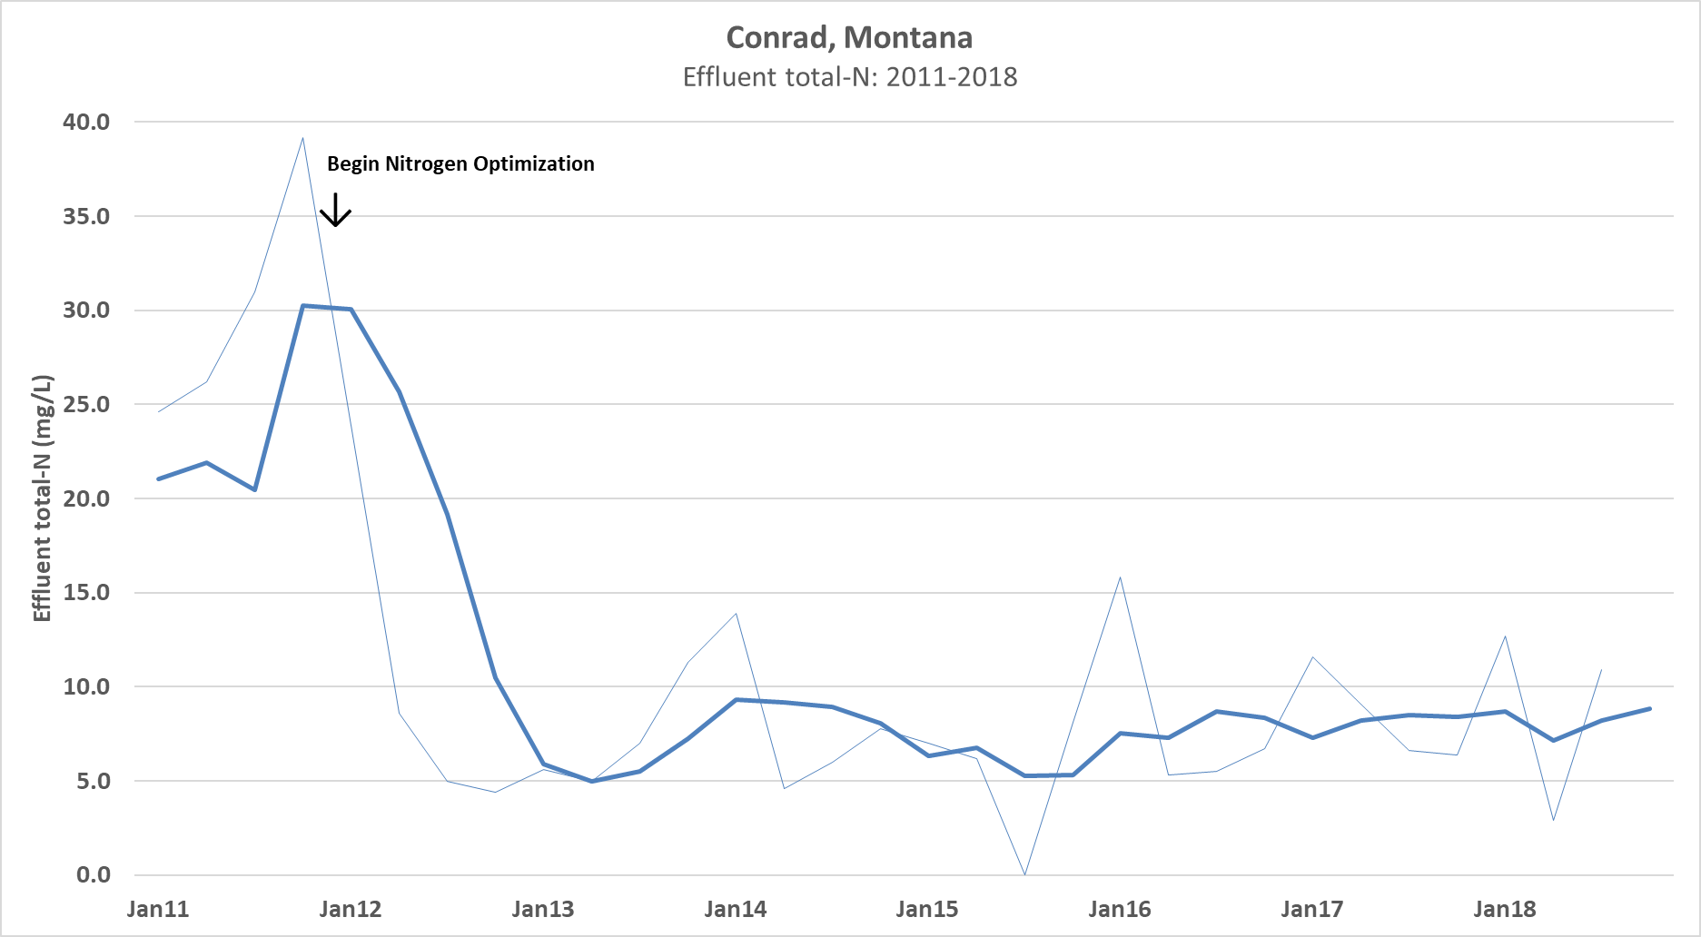

Slide 47
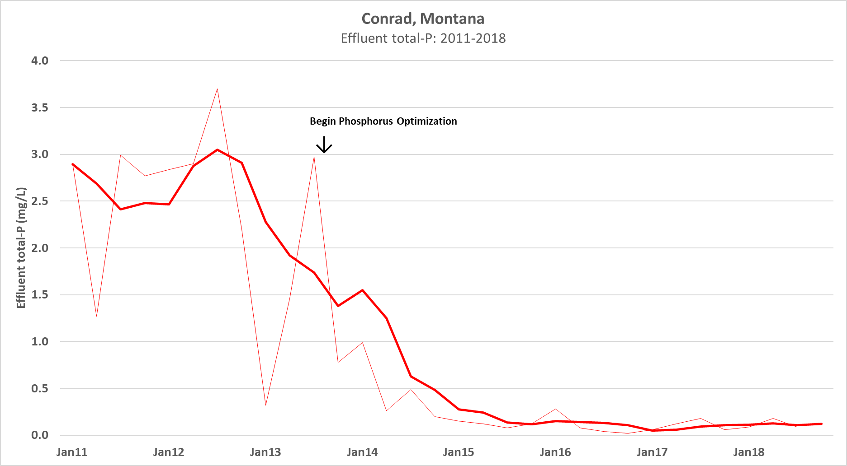

Slide 48
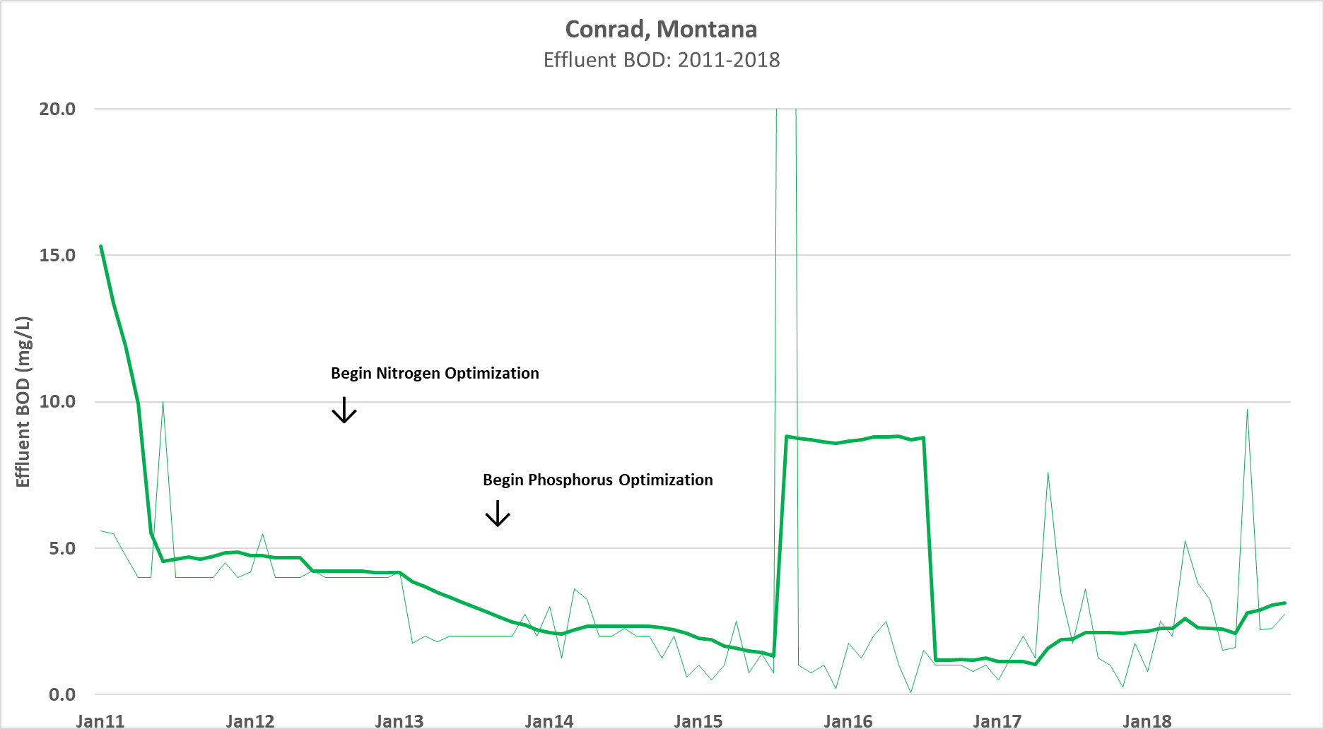

Slide 49
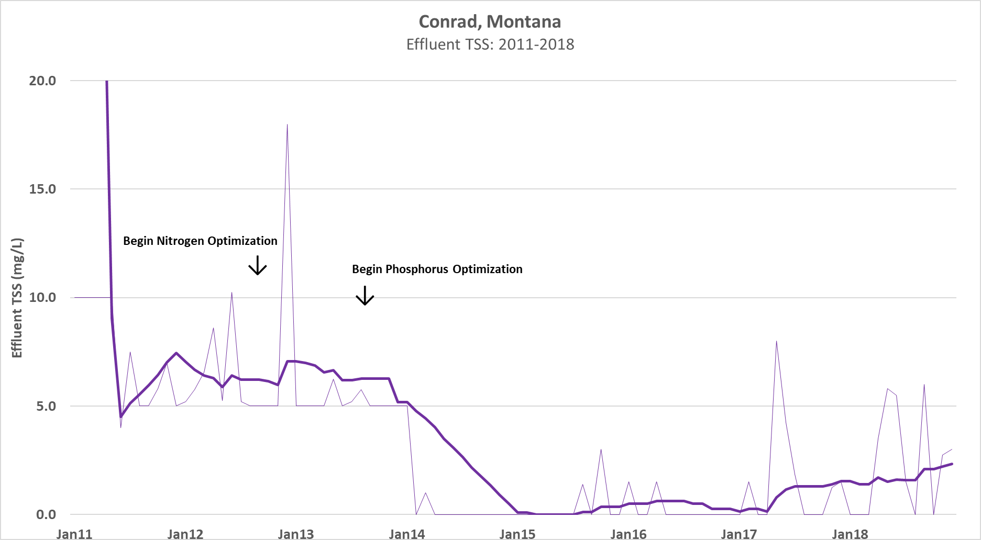

Slide 50
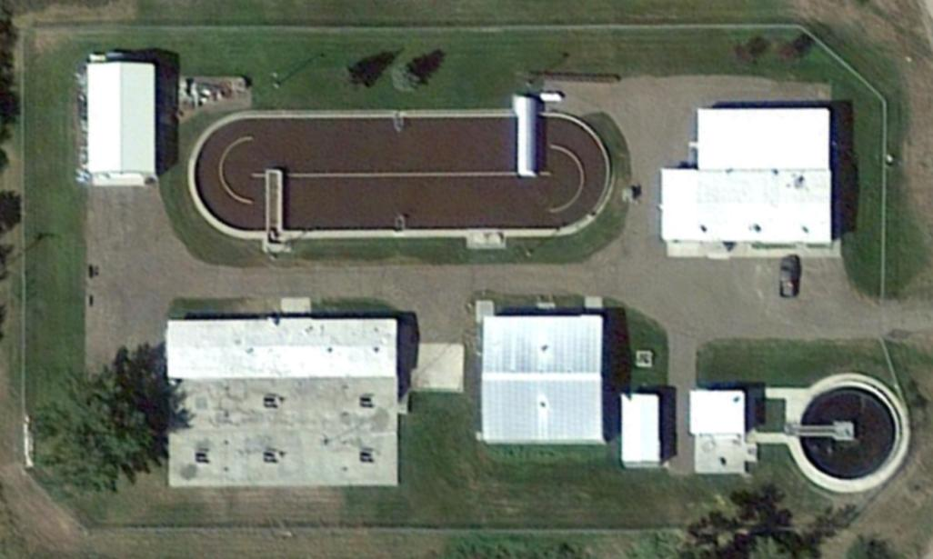
Chinook, Montana Population: 1,250 0.5 MGD design flow

Slide 51
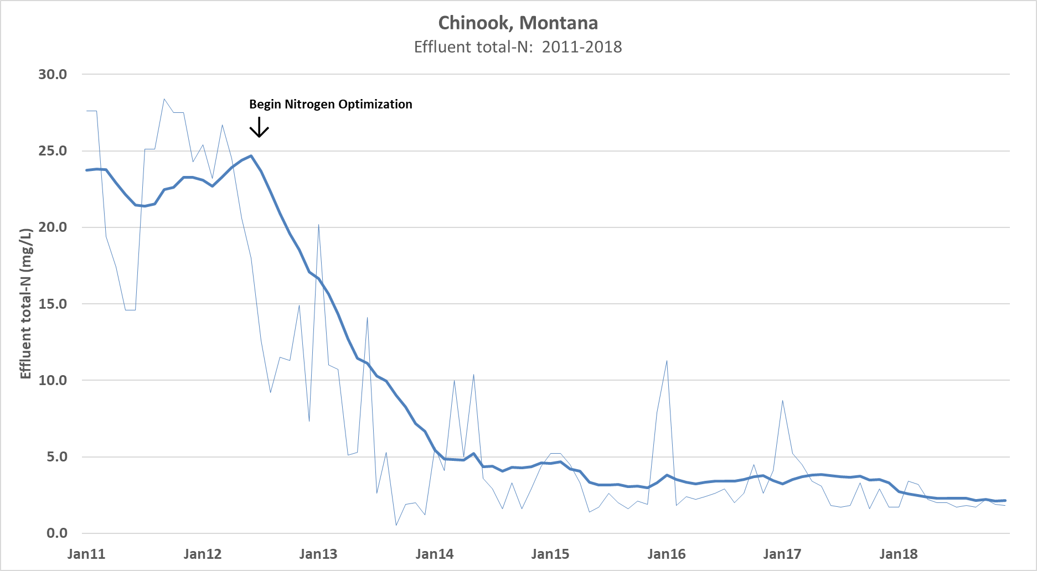

Slide 52
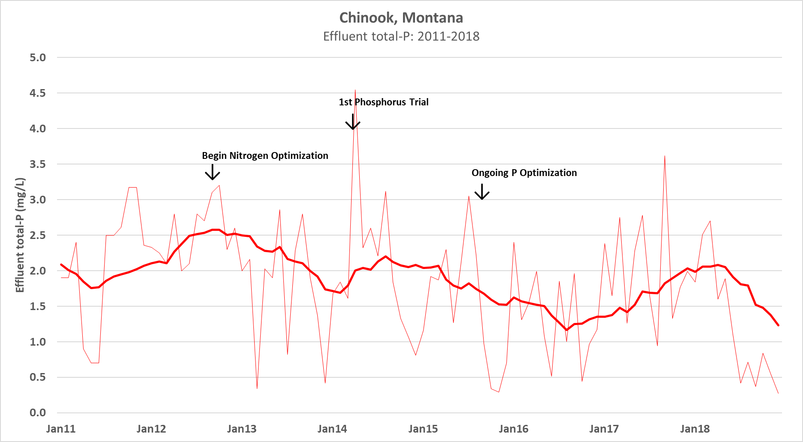

Slide 53
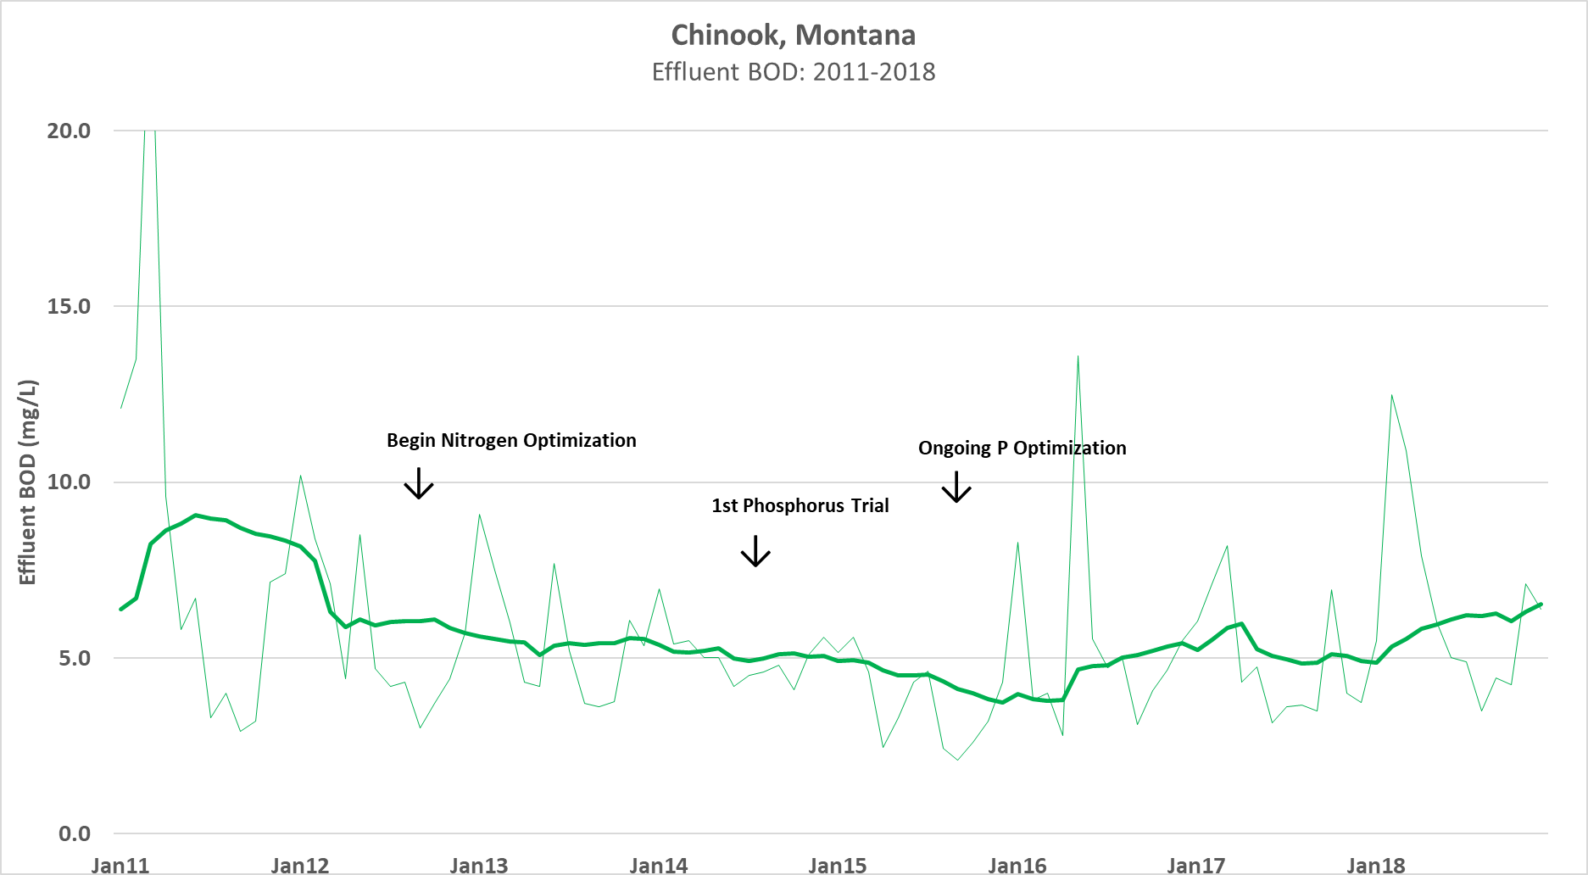

Slide 54
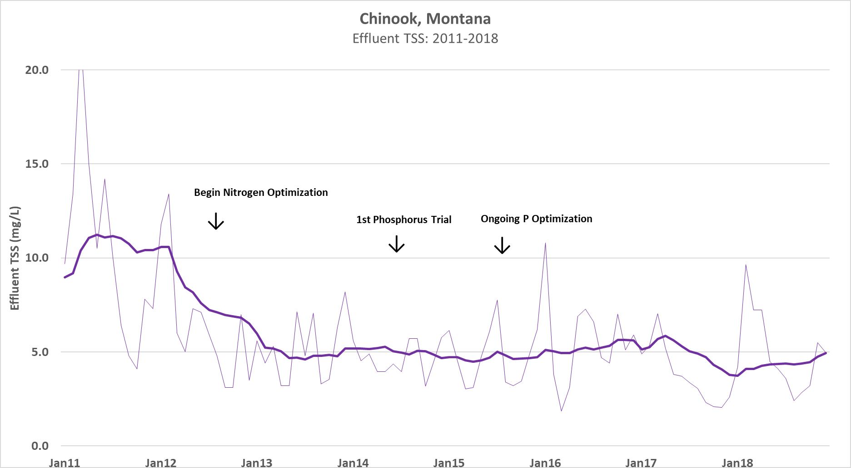

Slide 55
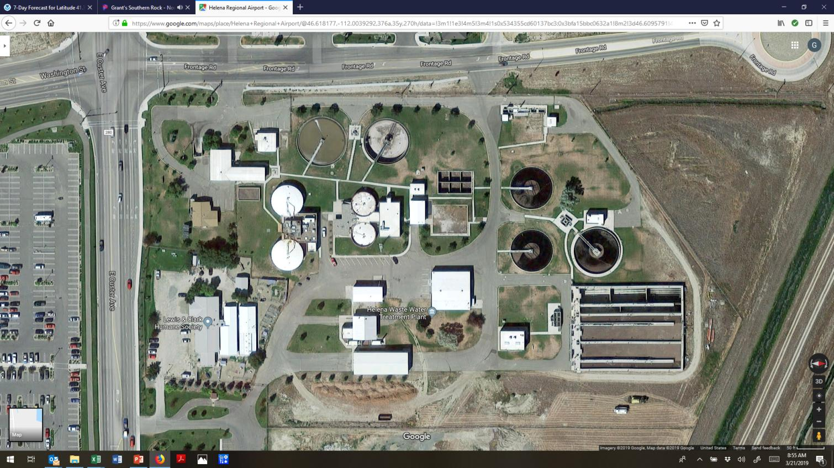
Helena, Montana Population: 31,500 5.4 MGD design flow

Slide 56
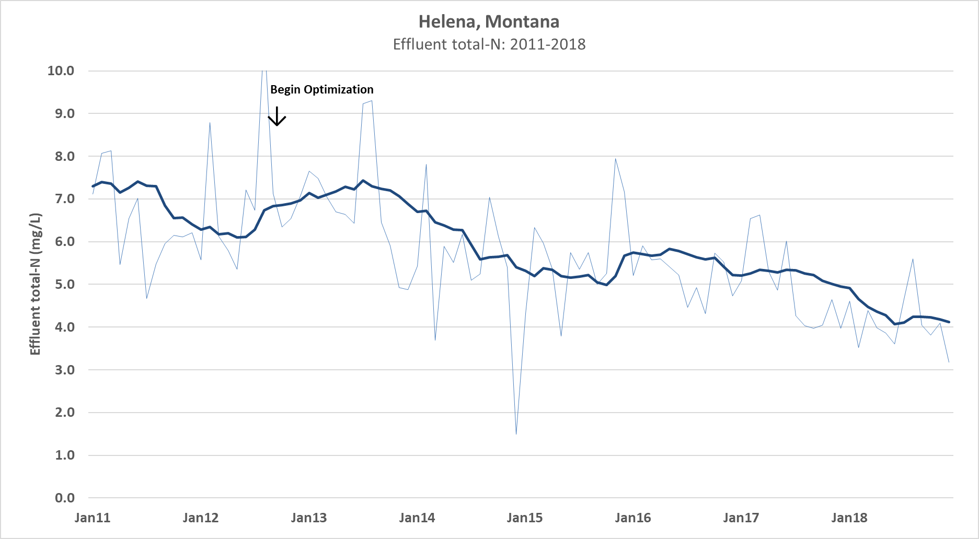

Slide 57
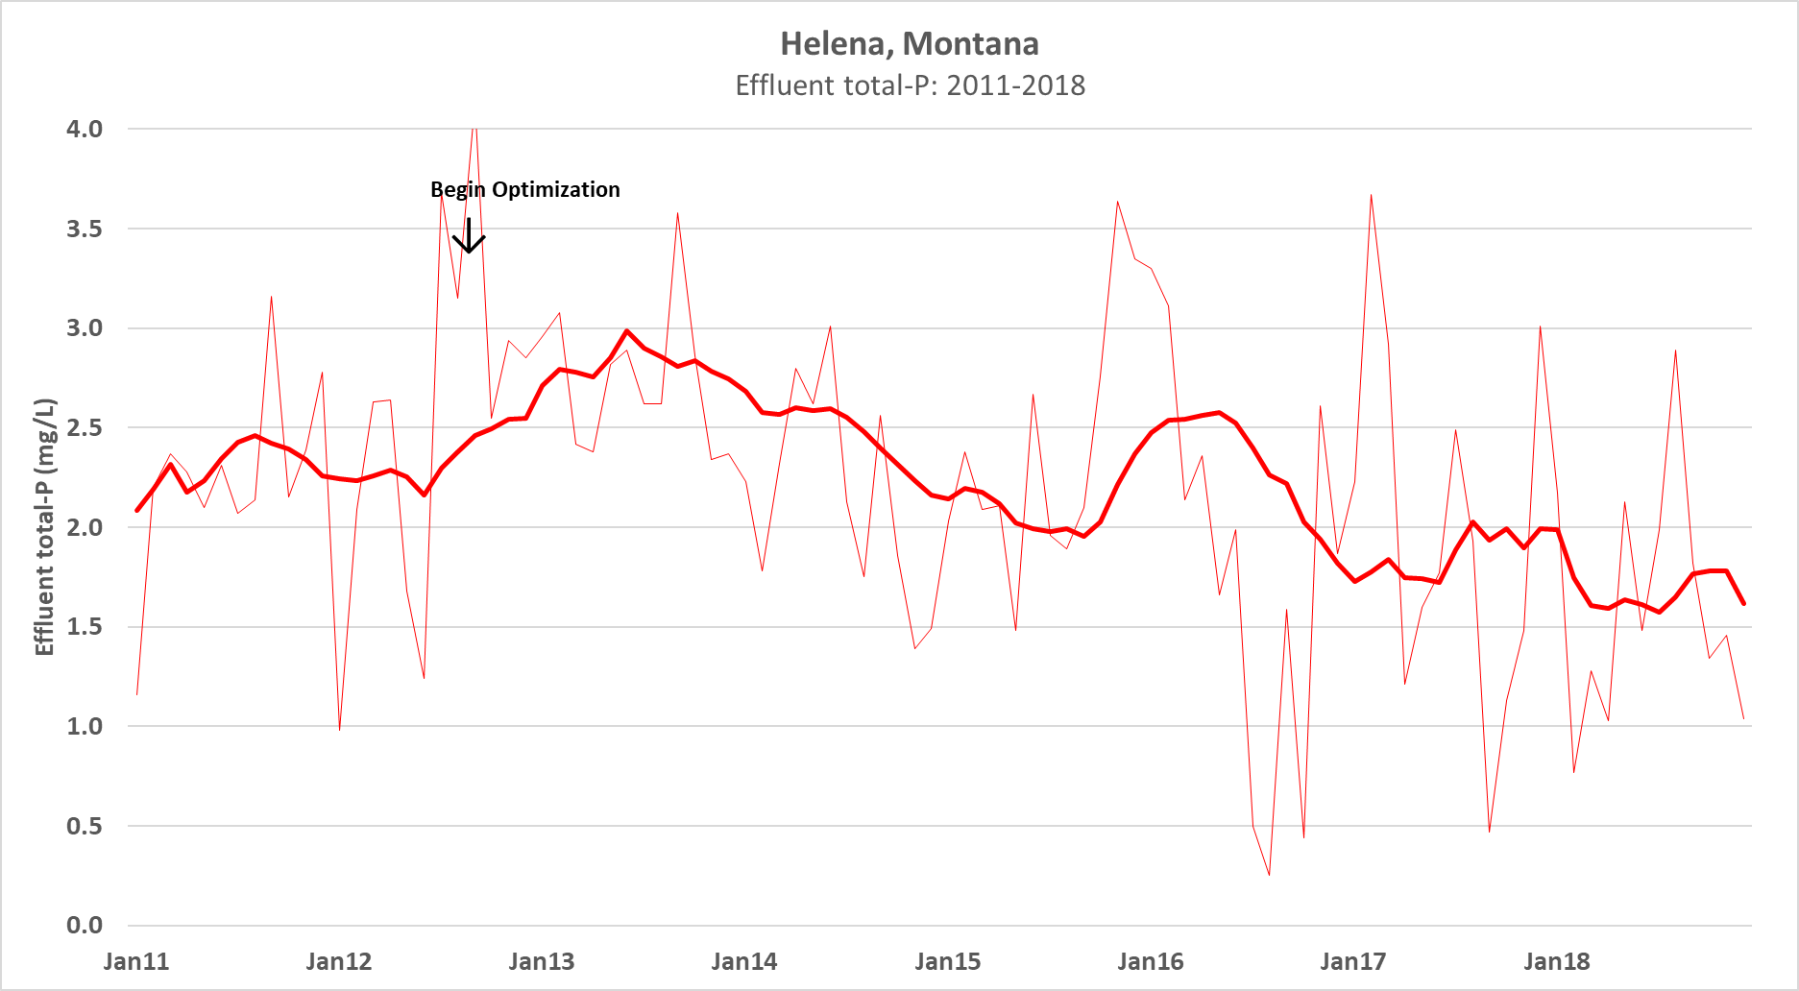

Slide 58
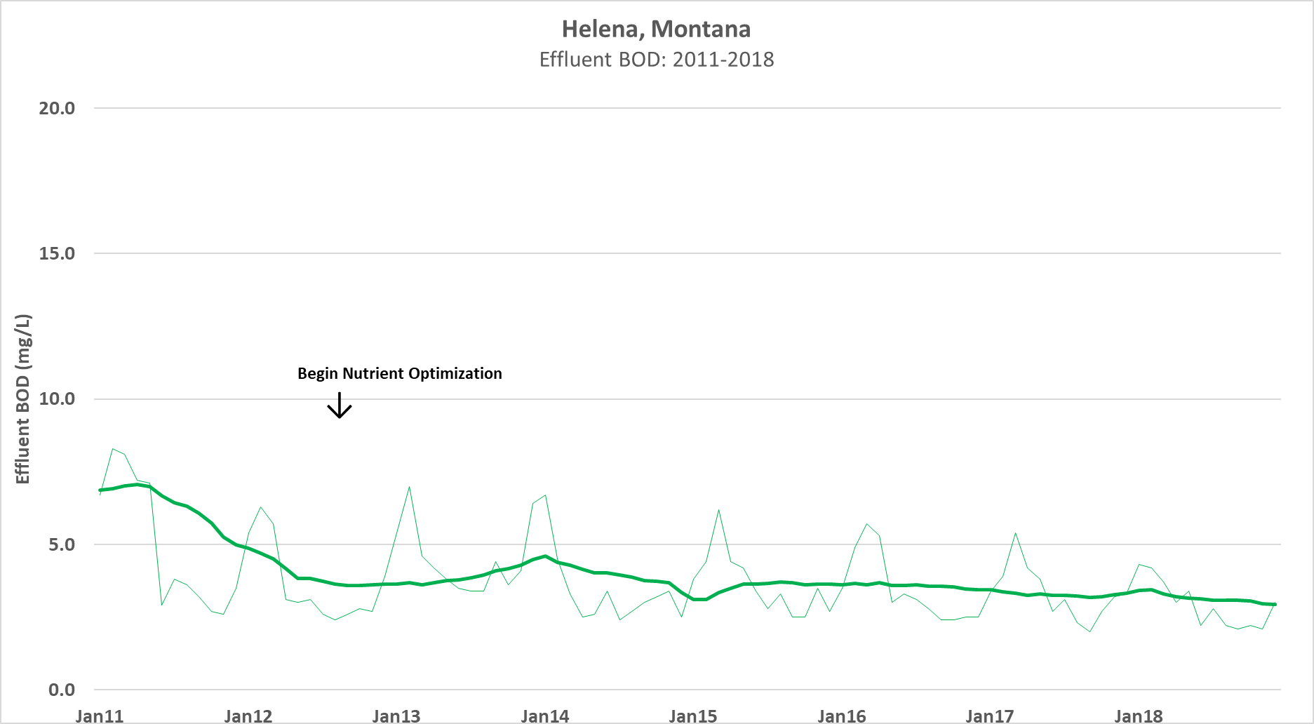

Slide 59
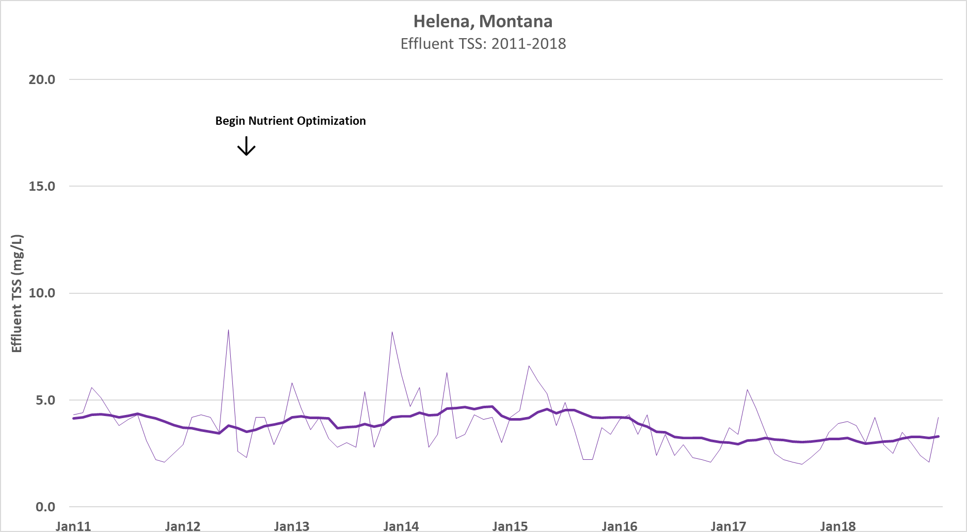

Slide 60
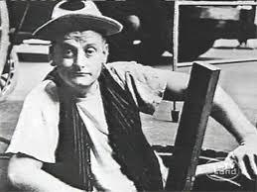
Comments & Questions
Grant Weaver
g.weaver@cleanwaterops.com

